Slide 1
Error characterization project
Weekly updates
Feb.05.2026

Slide 2
Why error characterization?
Identifying and characterizing types (not extent, type) of segmentation errors made by 3D AI segmentation-based models on CT scans:
So that the community can build models that are adept at avoiding such errors.

Slide 3
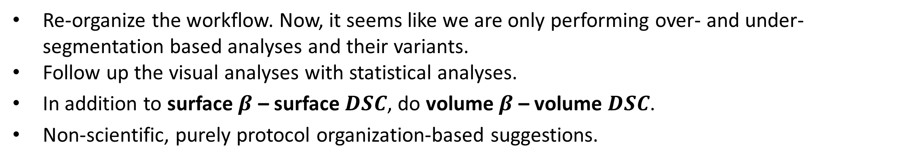
Recap of the past week
– What was done last week? What is to be done next week?
Past week: What was expected, what was accomplished?
Re-organize the workflow. Now, it seems like we are only performing over- and under-segmentation based analyses and their variants.
Follow up the visual analyses with statistical analyses.
In addition to surface $β$ – surface $DSC$, do volume $β$ – volume $DSC$.
Non-scientific, purely protocol organization-based suggestions.
Additionally: Combined C-score (unifying $β and DSC$) – for both volume and surface area
Next week: What is expected?
Complete implementation of C score for shape match but low DSC (mis-segmentation) versus over/ under segmentation.
Formulate metric to quantify connected component behavior → based on observation on TotalSegmentator.
[4] Jakob Wasserthal et al, “TotalSegmentator,” Radiology: Artificial Intelligence, 2023.

Slide 4
What questions are we asking specifically?
Q1: Can we rank organs as per susceptibility to being under- or over-segmented?
Q2: Organ-wise characterization of more nuanced errors
Comparative analyses: How does the segmentation model erroneously alter the segmentation characteristics of the organ?
Causal analyses: What features lead to what kinds of errors?

Slide 5
Error characterization protocol
Aims (2)
Q3: Magnitude and direction of error relative to the organ
Q4: Which organ-specific features are scalable, and by how much?
Comparative analyses: What are the exceptions?
Causal analyses: Why the exceptions?

Slide 6
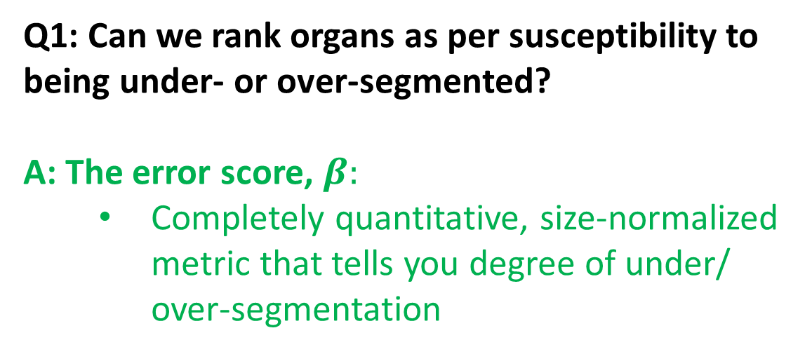
How do we answer these questions?
Q1: Can we rank organs as per susceptibility to being under- or over-segmented?
A: The error score, $β:$
Completely quantitative, size-normalized metric that tells you degree of under/ over-segmentation

Slide 7
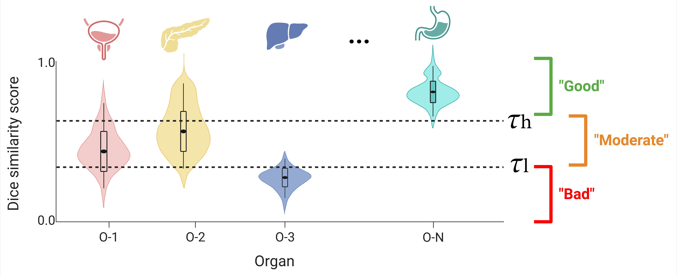
How is our Phase 1 different from literature?
– Putting our “What” and “How” in perspective
Q1: Ranking organs as per susceptibility to being under- or over-segmented
State-of-the-art (segmentation QA)
Our Phase 1 (extent of under-/ over-segmentation)

Slide 8
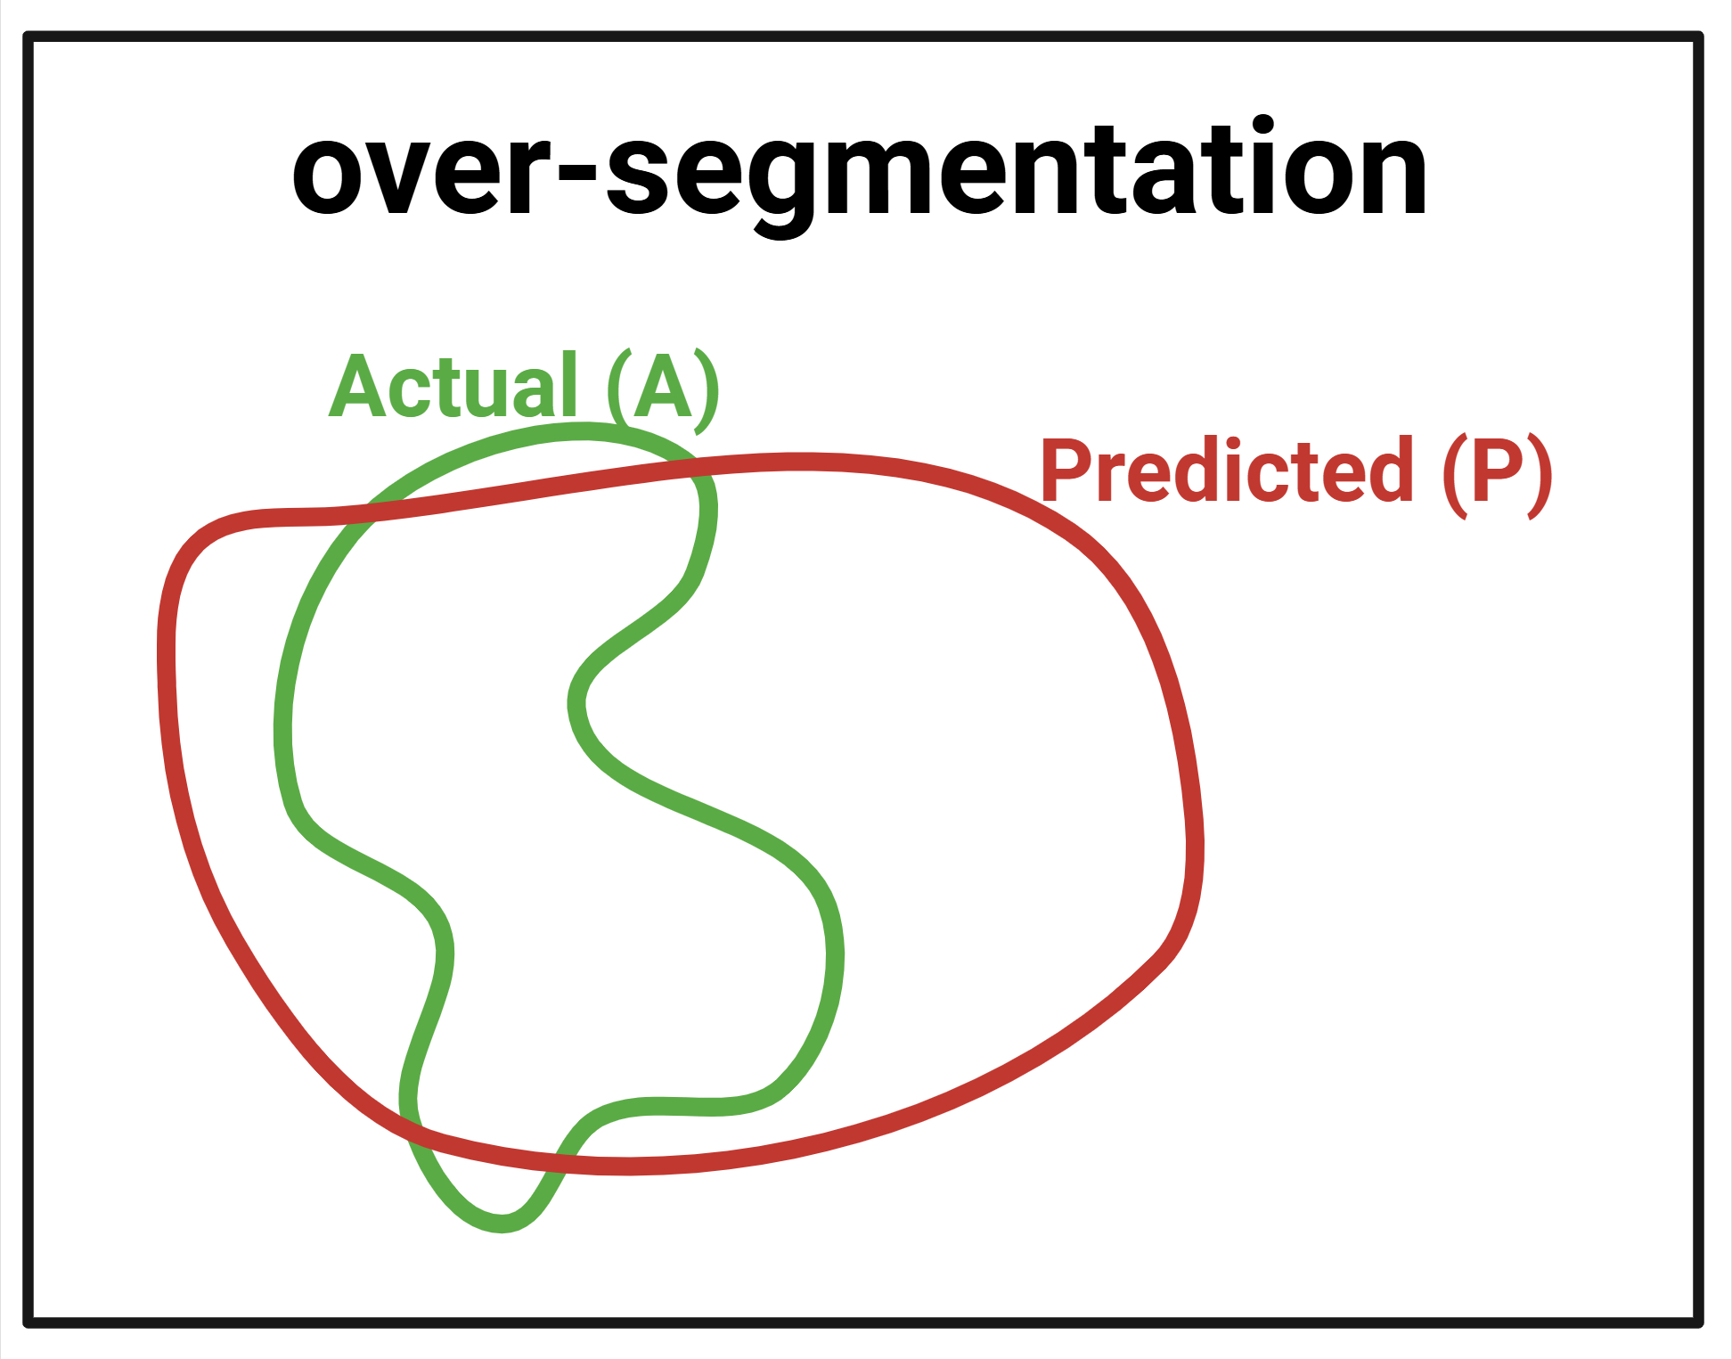
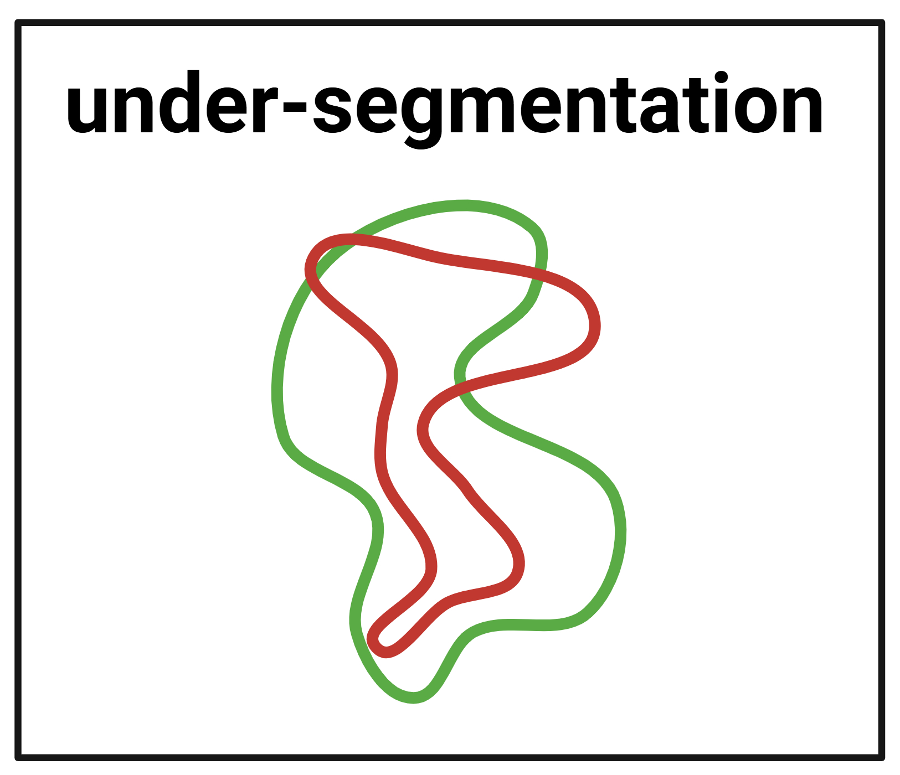
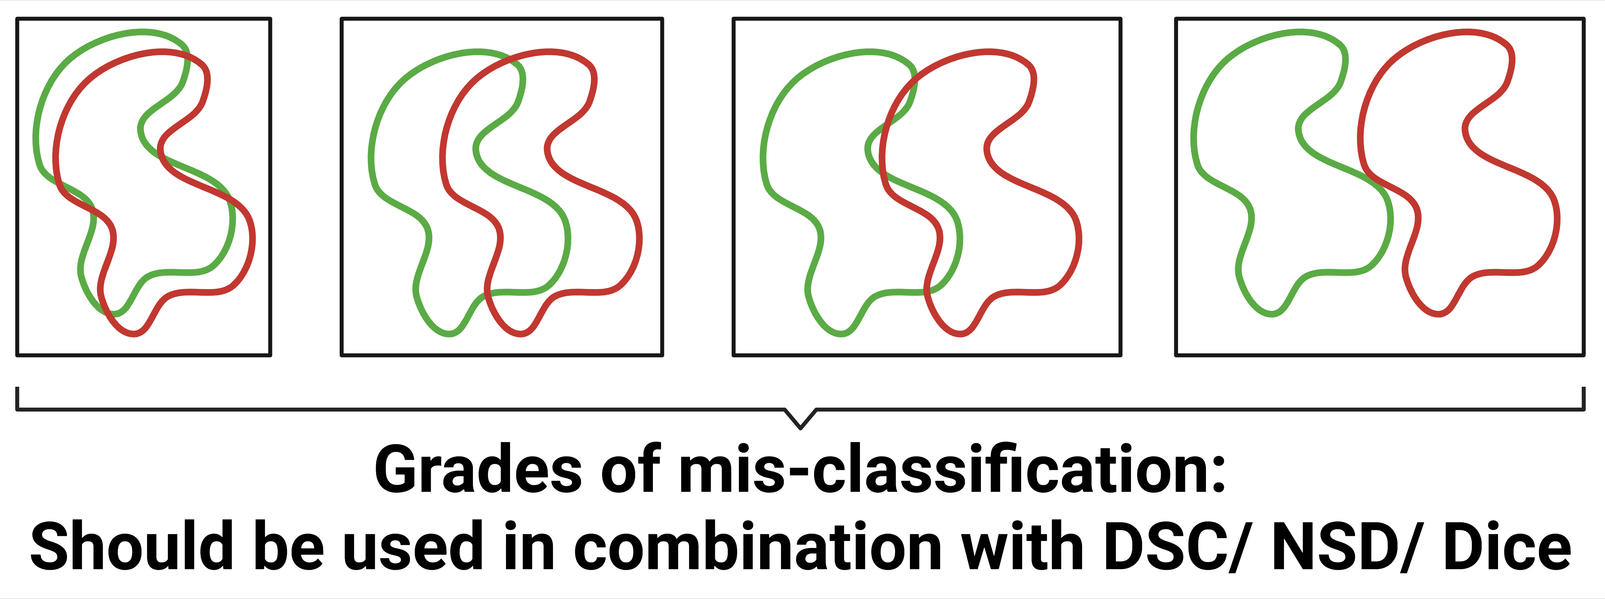
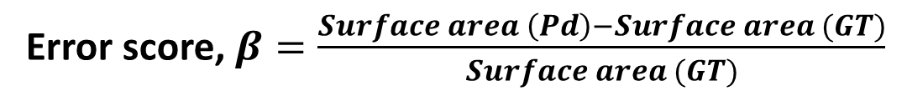
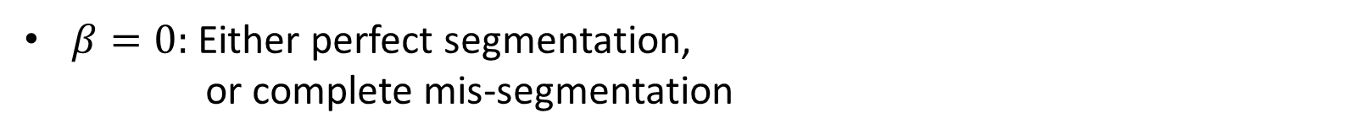
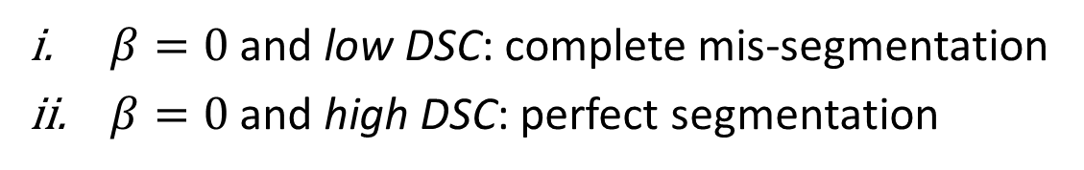
Methods
– Extending the “How”
Q1: Ranking organs as per susceptibility to being under- or over-segmented (2)
Error score, $β=\frac{Surface area \left(Pd\right)−Surface area (GT)}{Surface area (GT)}$
$β>0:$ over-segmentation
$β<0:$ under-segmentation
$β=0:$ Either perfect segmentation,
or complete mis-segmentation
$β=0$ and low DSC: complete mis-segmentation
$β=0$ and high DSC: perfect segmentation
Therefore, setting an upper and lower bound (thresholds) on $β$ and DSC solve the problem.

Slide 9
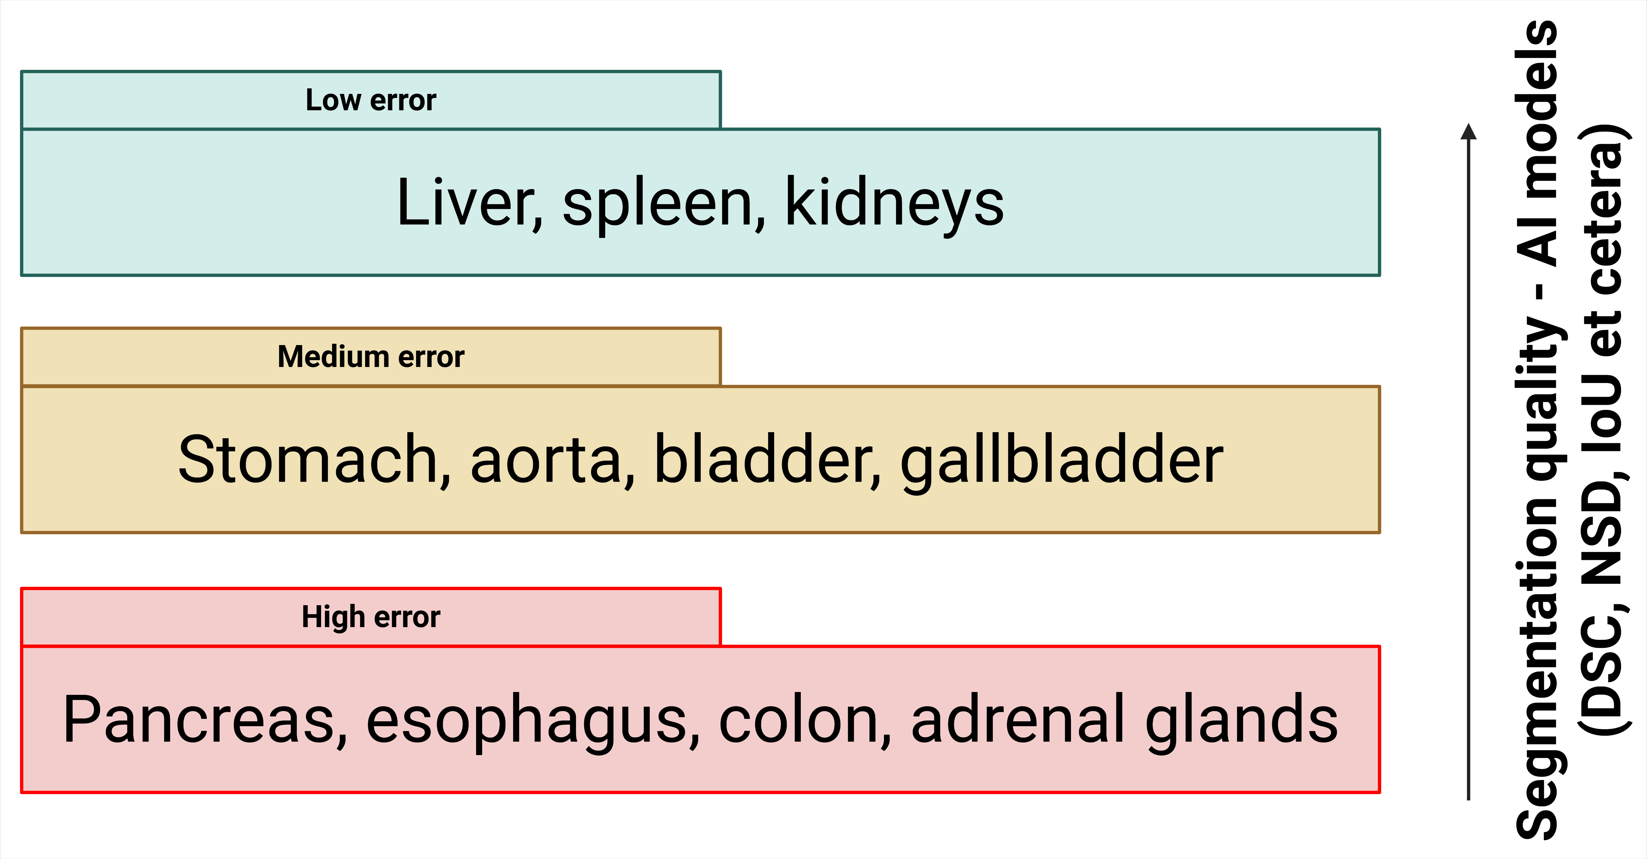
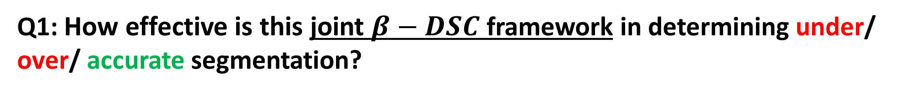
Results
Efficacy of the joint $β−DSC$ framework
Q1: How effective is this joint $β−DSC$ framework in determining under/ over/ accurate segmentation?
Examples shown on 6 samples per organ. (Note: only 3D rendering, not 2D.)
But first, let us recap the organs of interest:
[1] Sun Kyung Jeon et al, “Fully-Automated Multi-Organ Segmentation …,” Scientific Reports, 2022.
[2] Xiangde Luo et al, “WORD,” Medical Image Analysis, 2022.
[3] Yuanfeng Ji et al, “AMOS,” arXiv, 2022.
[4] Jakob Wasserthal et al, “TotalSegmentator,” Radiology: Artificial Intelligence, 2023.

Slide 10
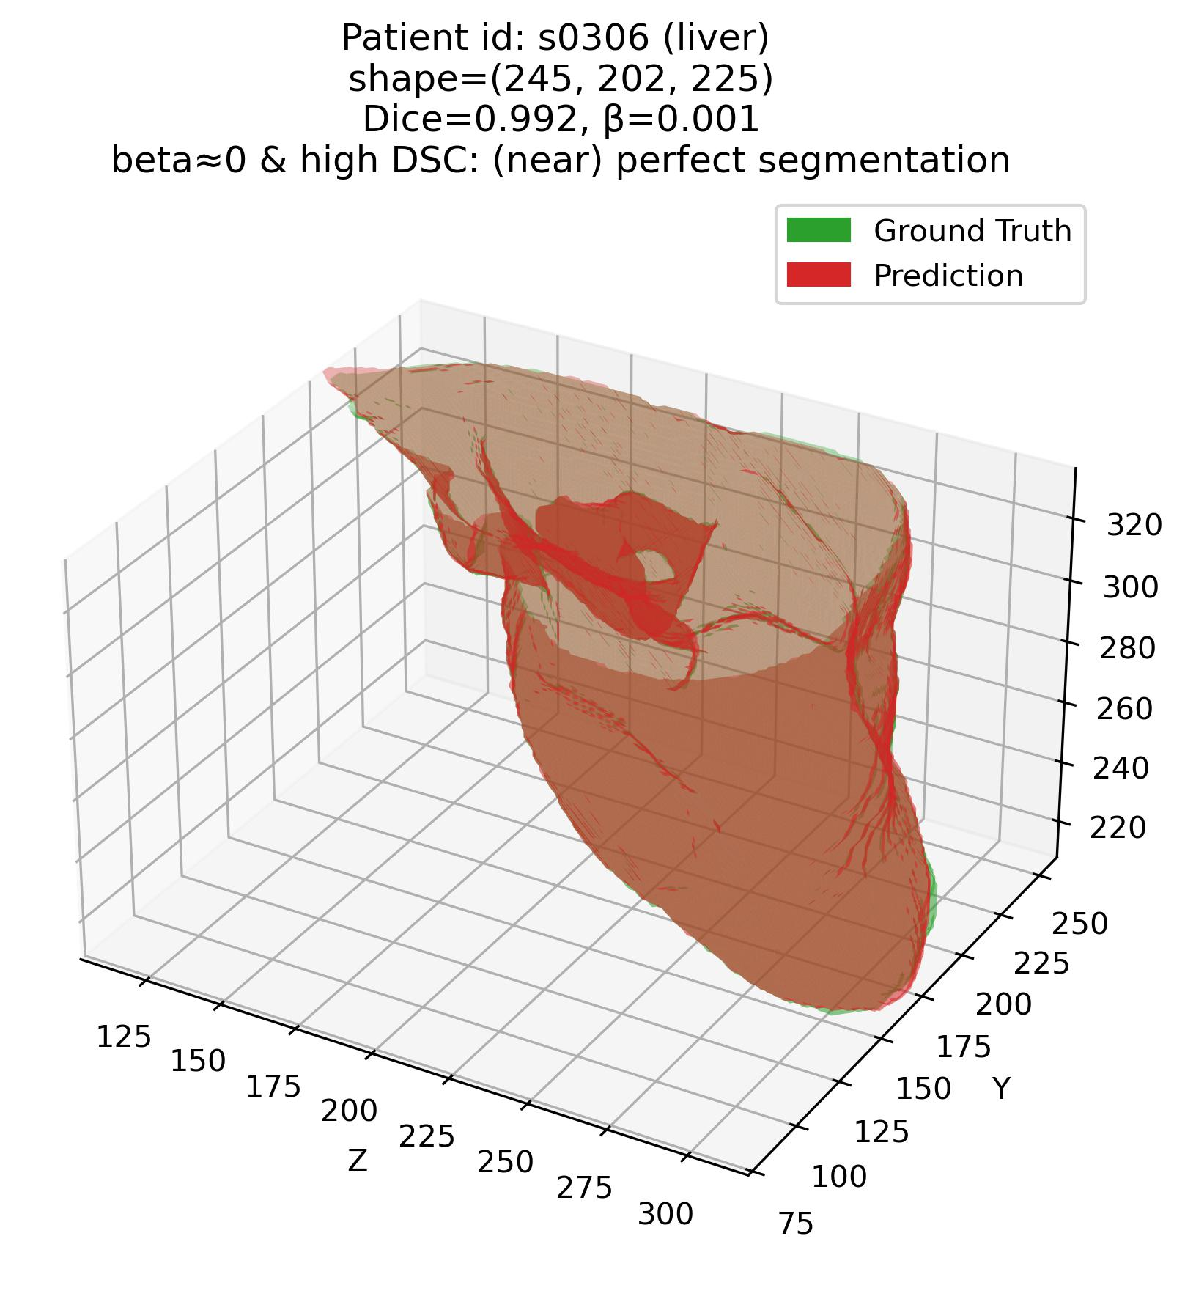
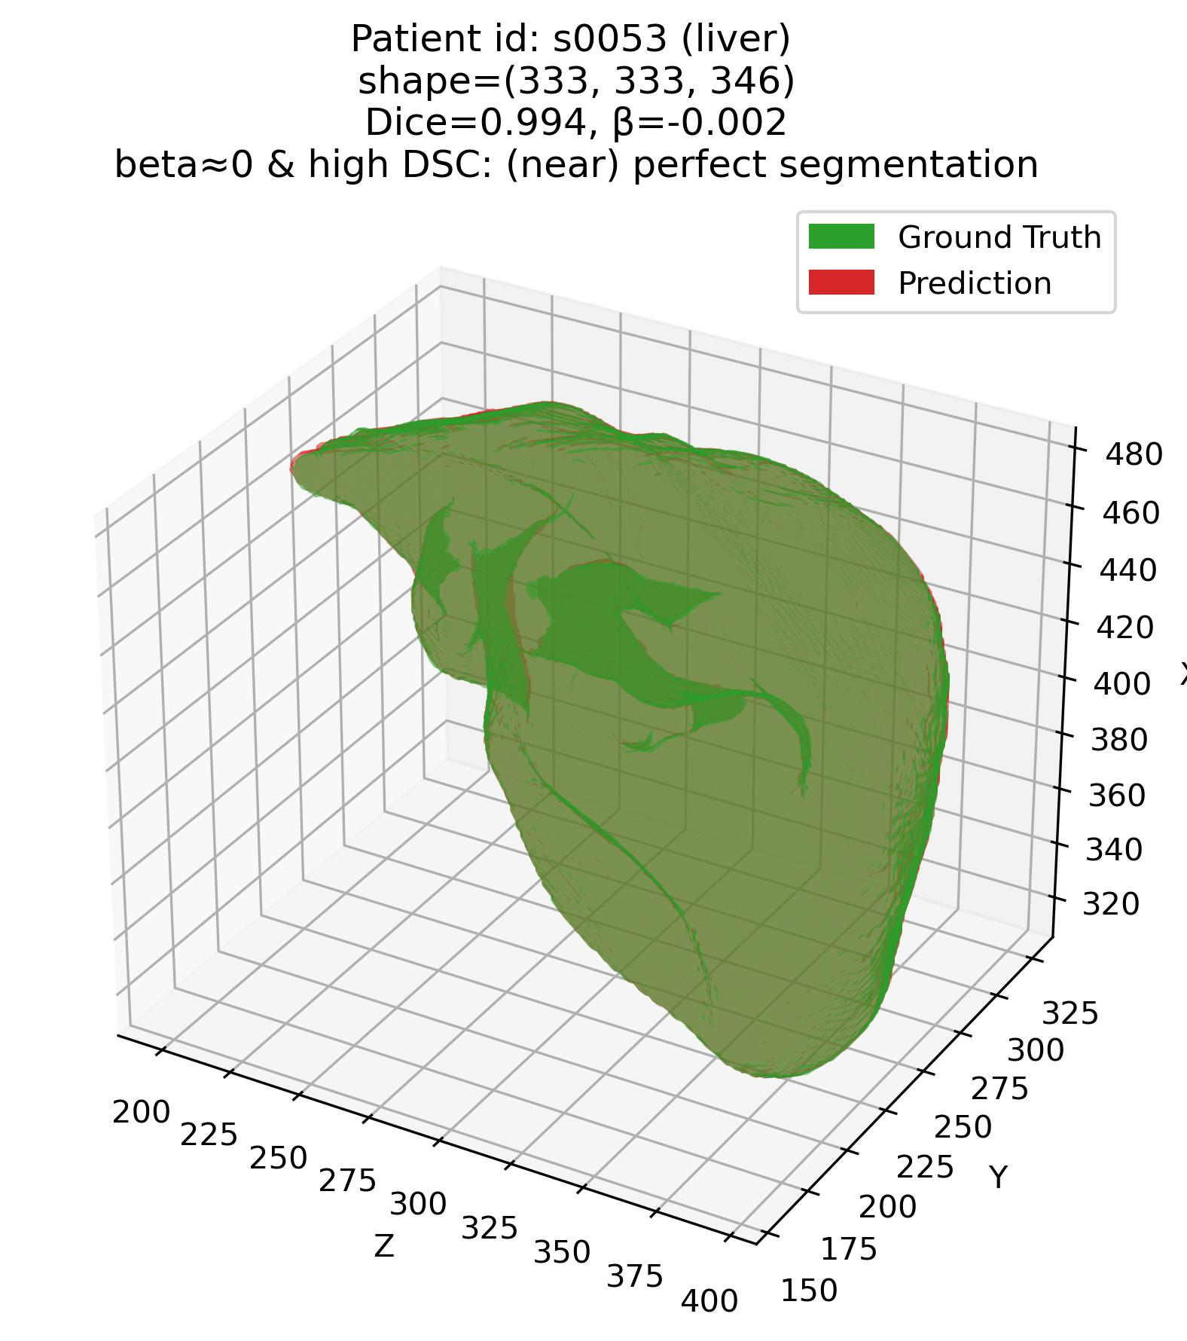
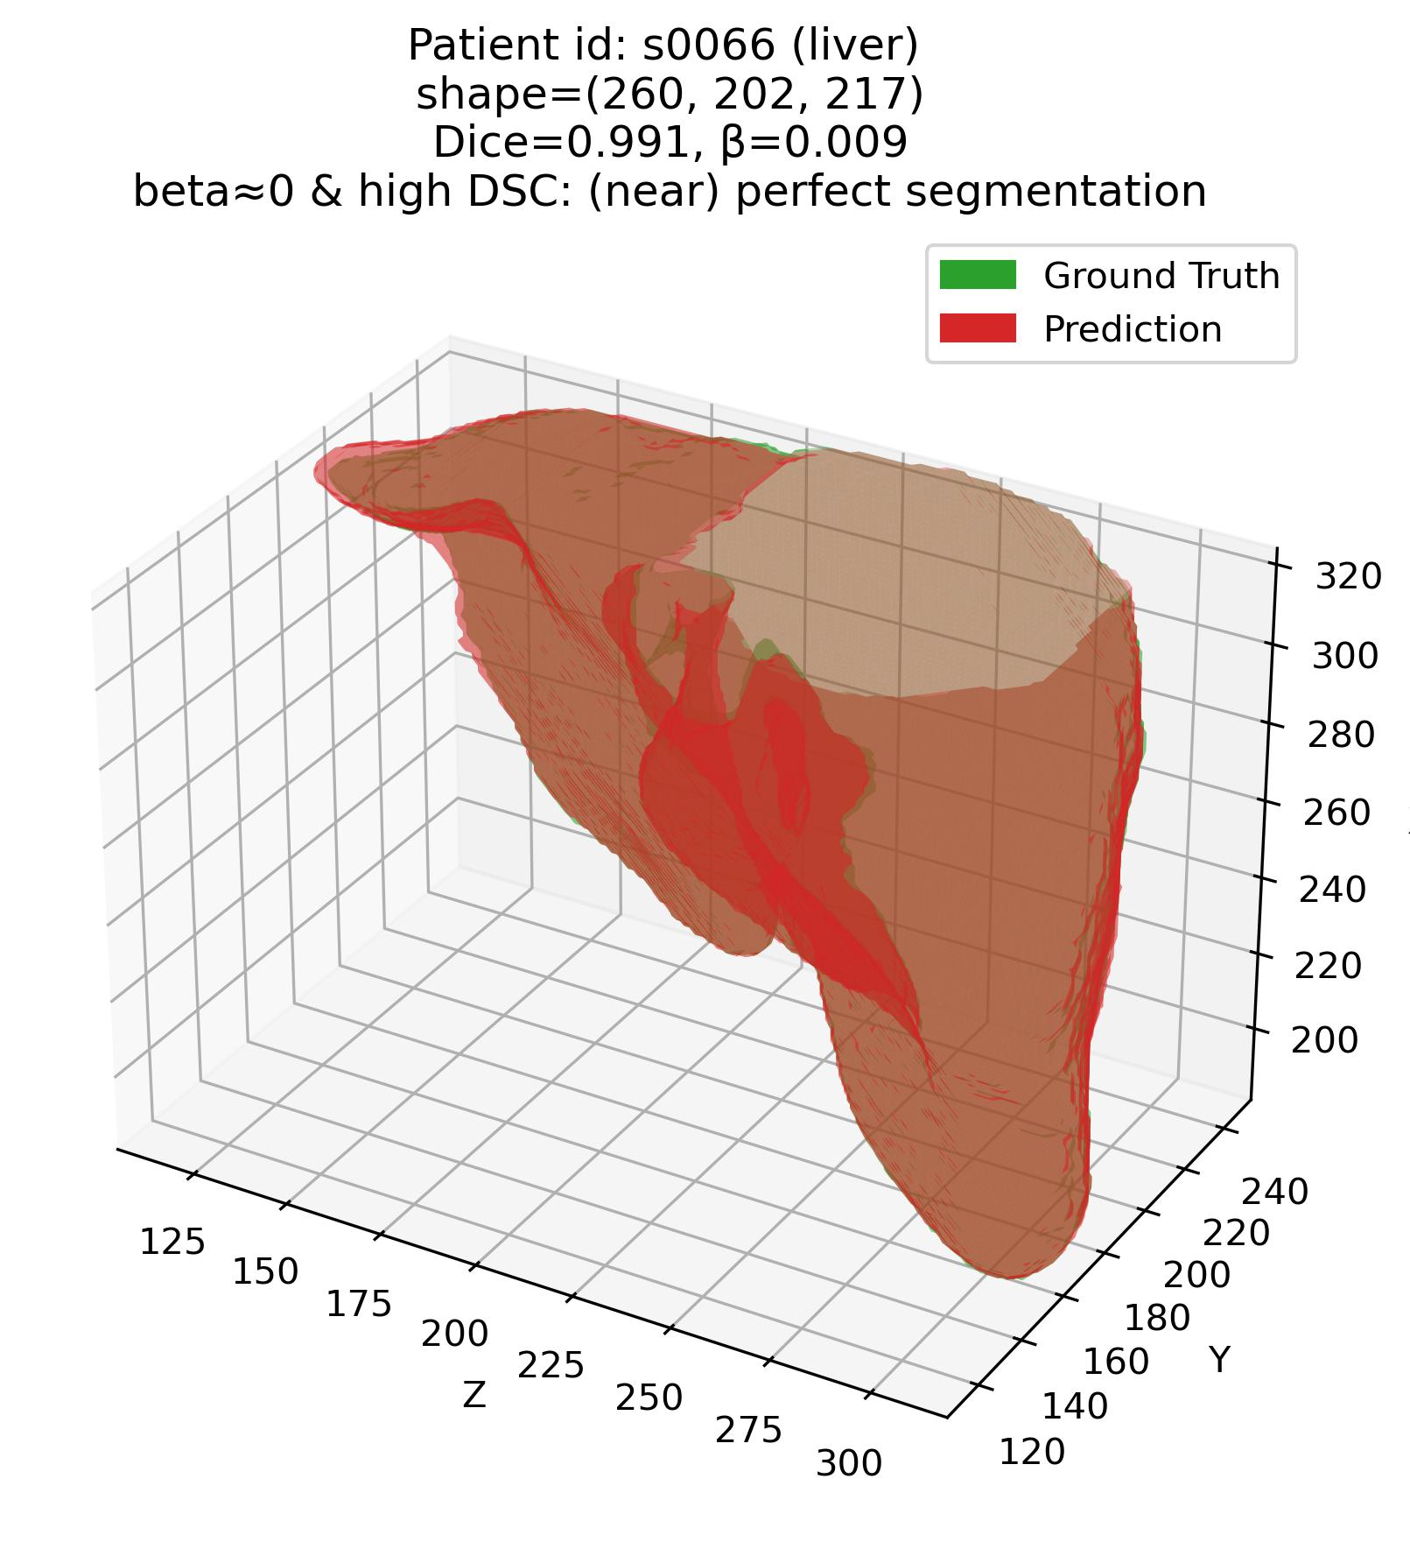



Results 1 – Visual
Efficacy of the joint $β−DSC$ framework
Q1: Some examples – 1. Liver (Easy – high DSC organ)
$${DSC}_{high}=80\%=0.80$$
|$β_{tolerance}|=2\%=0.02$
$$\&$$

Slide 11
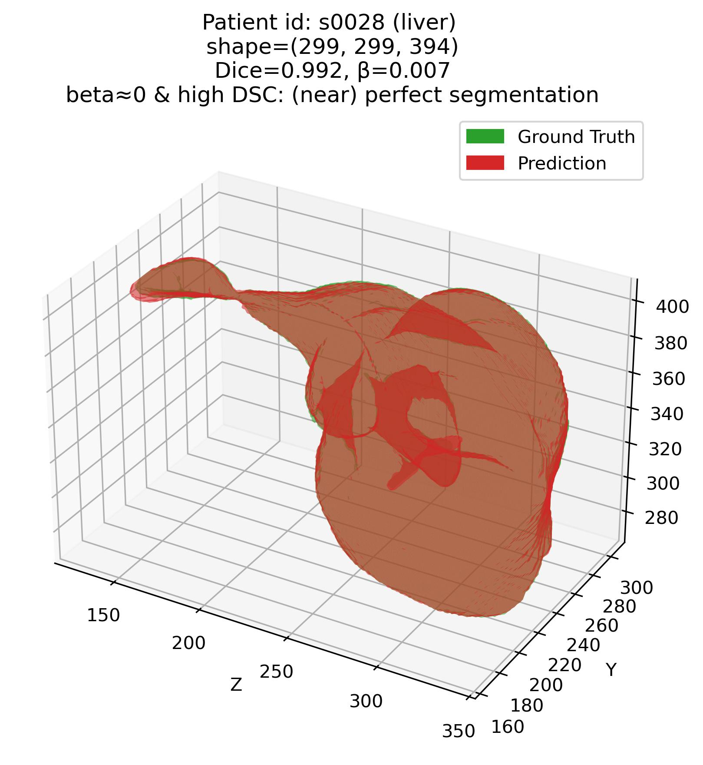
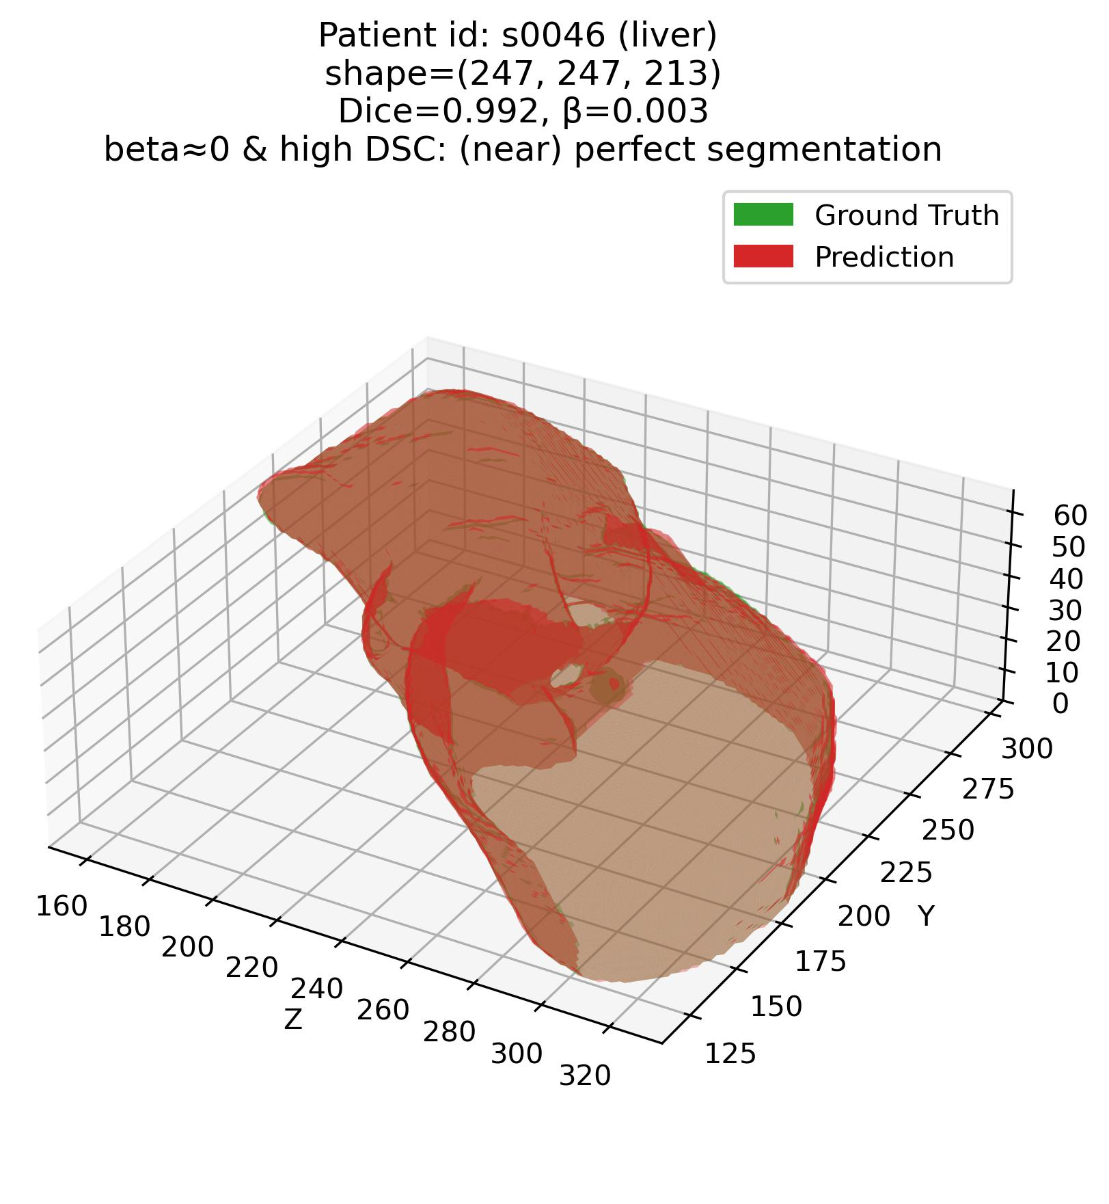
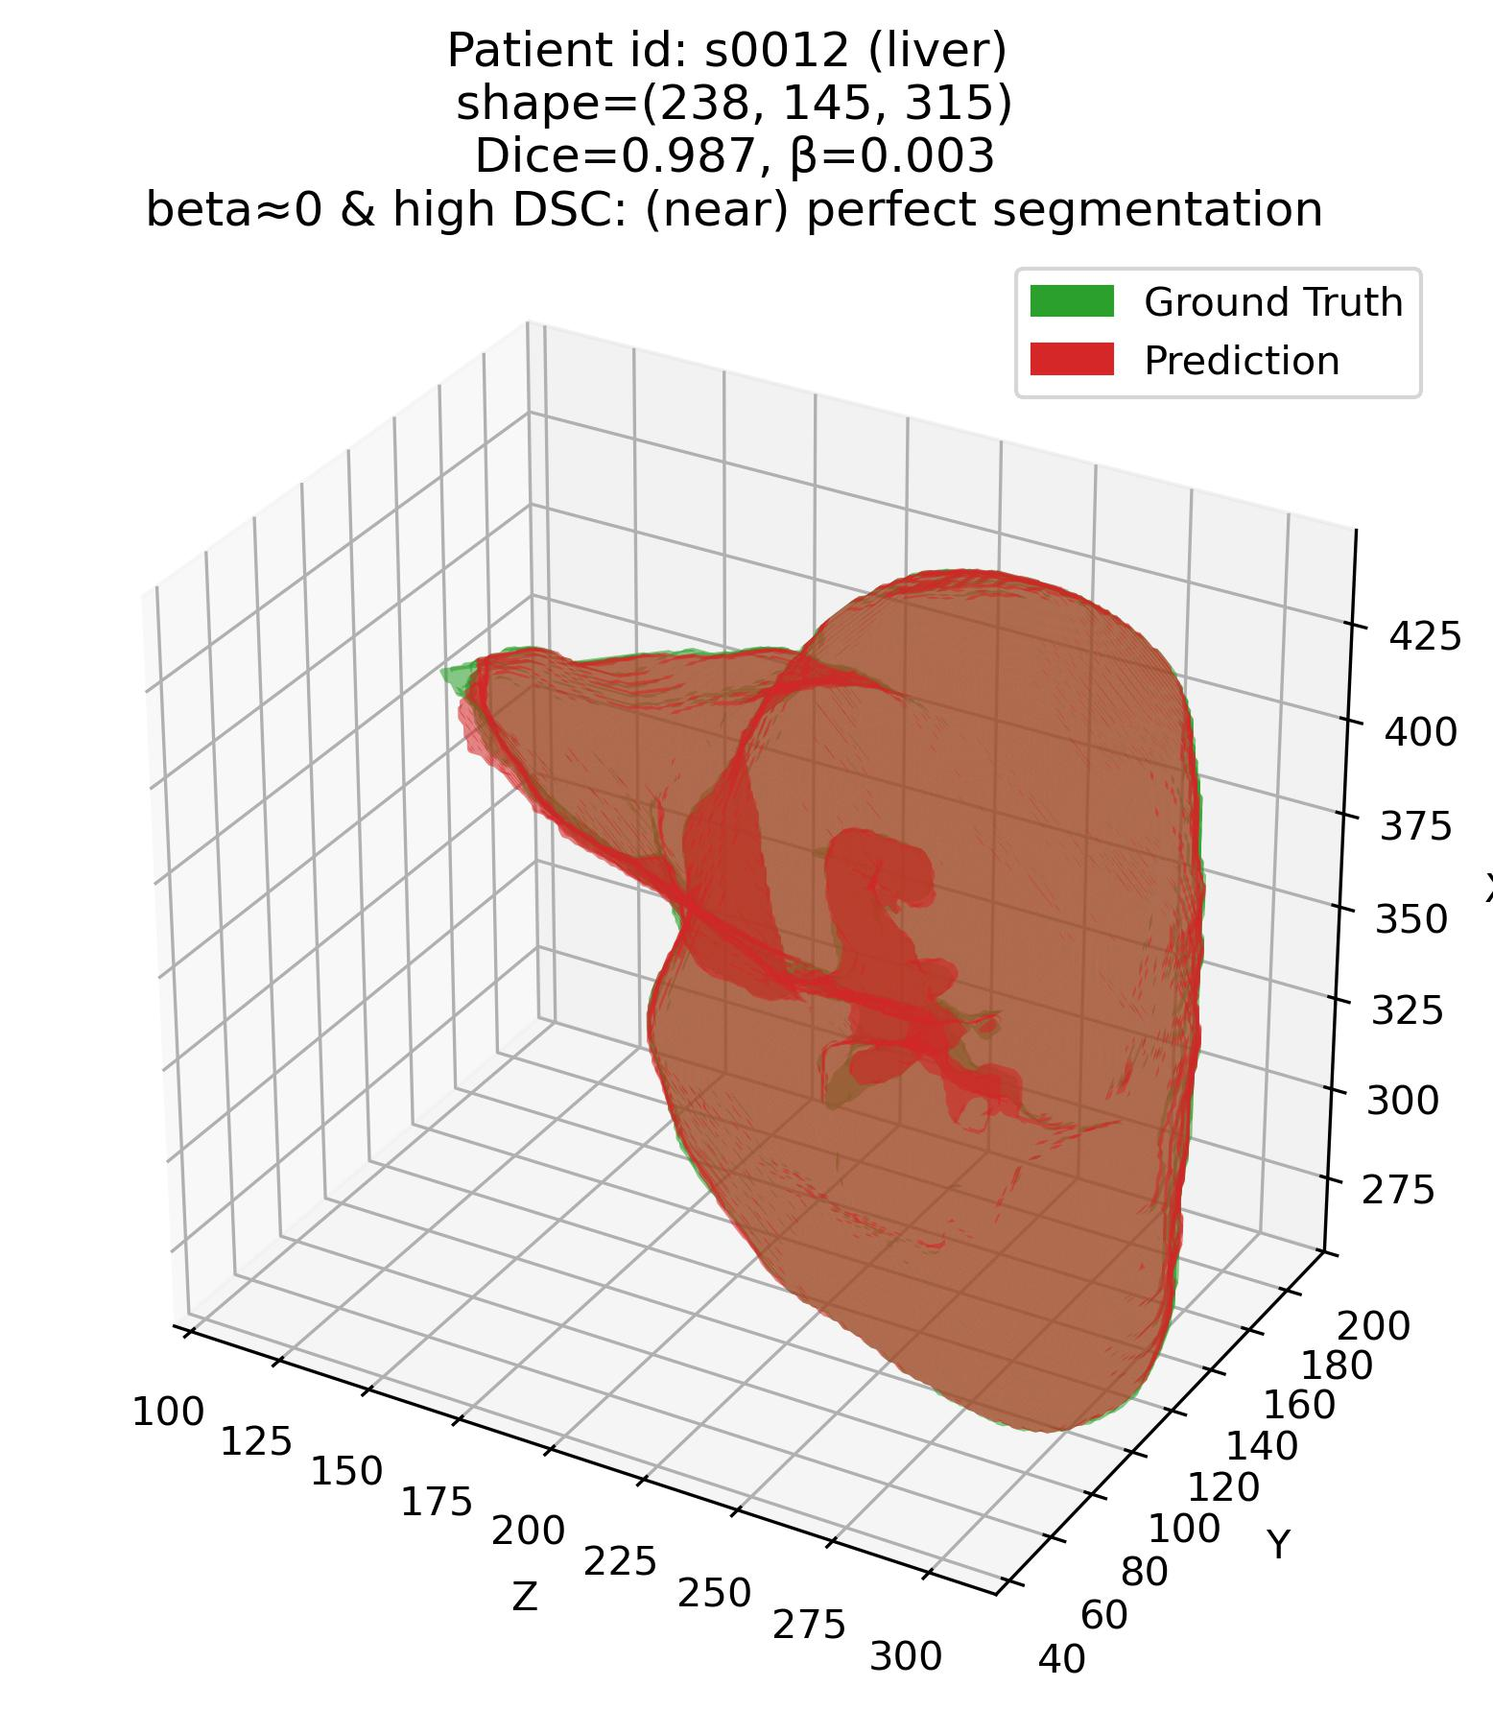
Results 1 – Visual
Efficacy of the joint $β−DSC$ framework
Q1: Some examples – 1. Liver (Easy – high DSC organ)

Slide 12
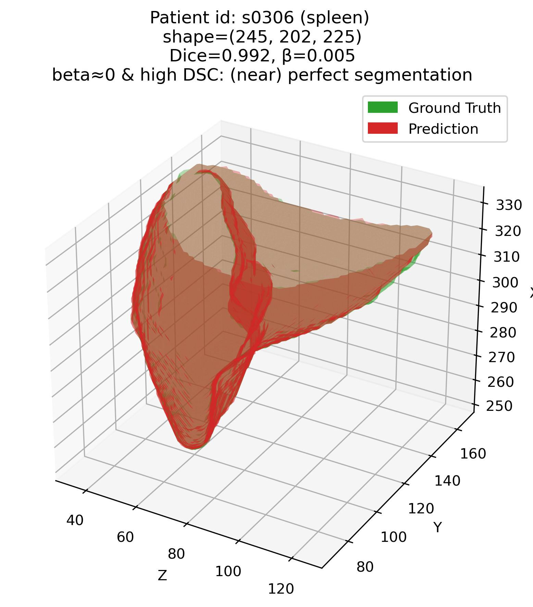
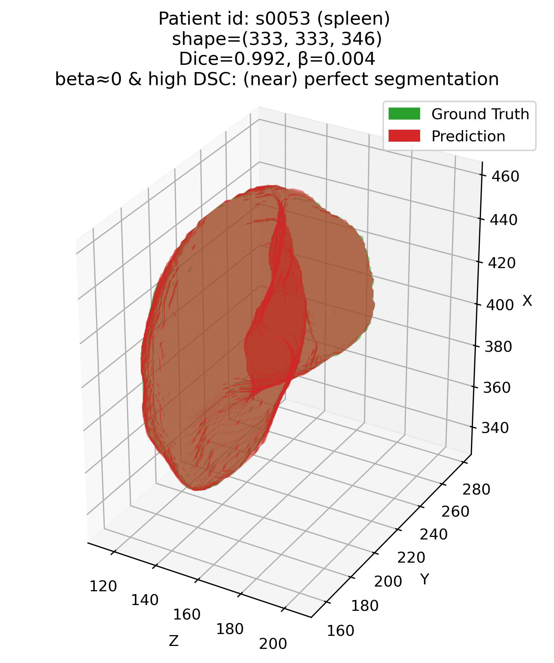
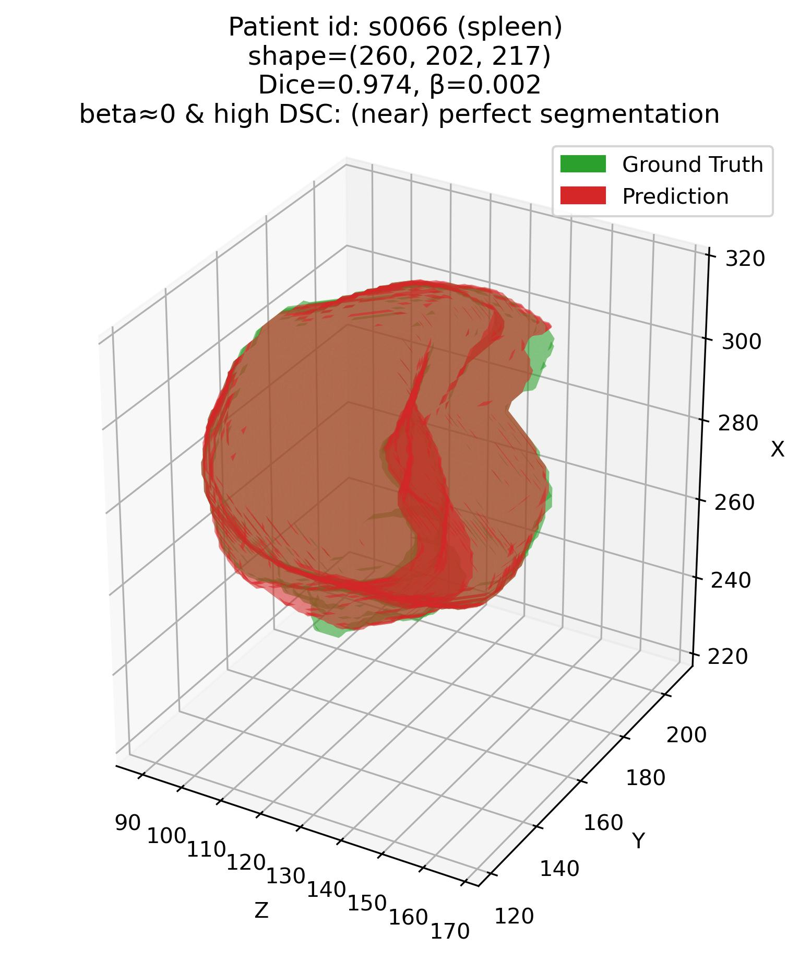
Results 1 – Visual
Efficacy of the joint $β−DSC$ framework
Q1: Some examples – 2. Spleen (Easy – high DSC organ)

Slide 13
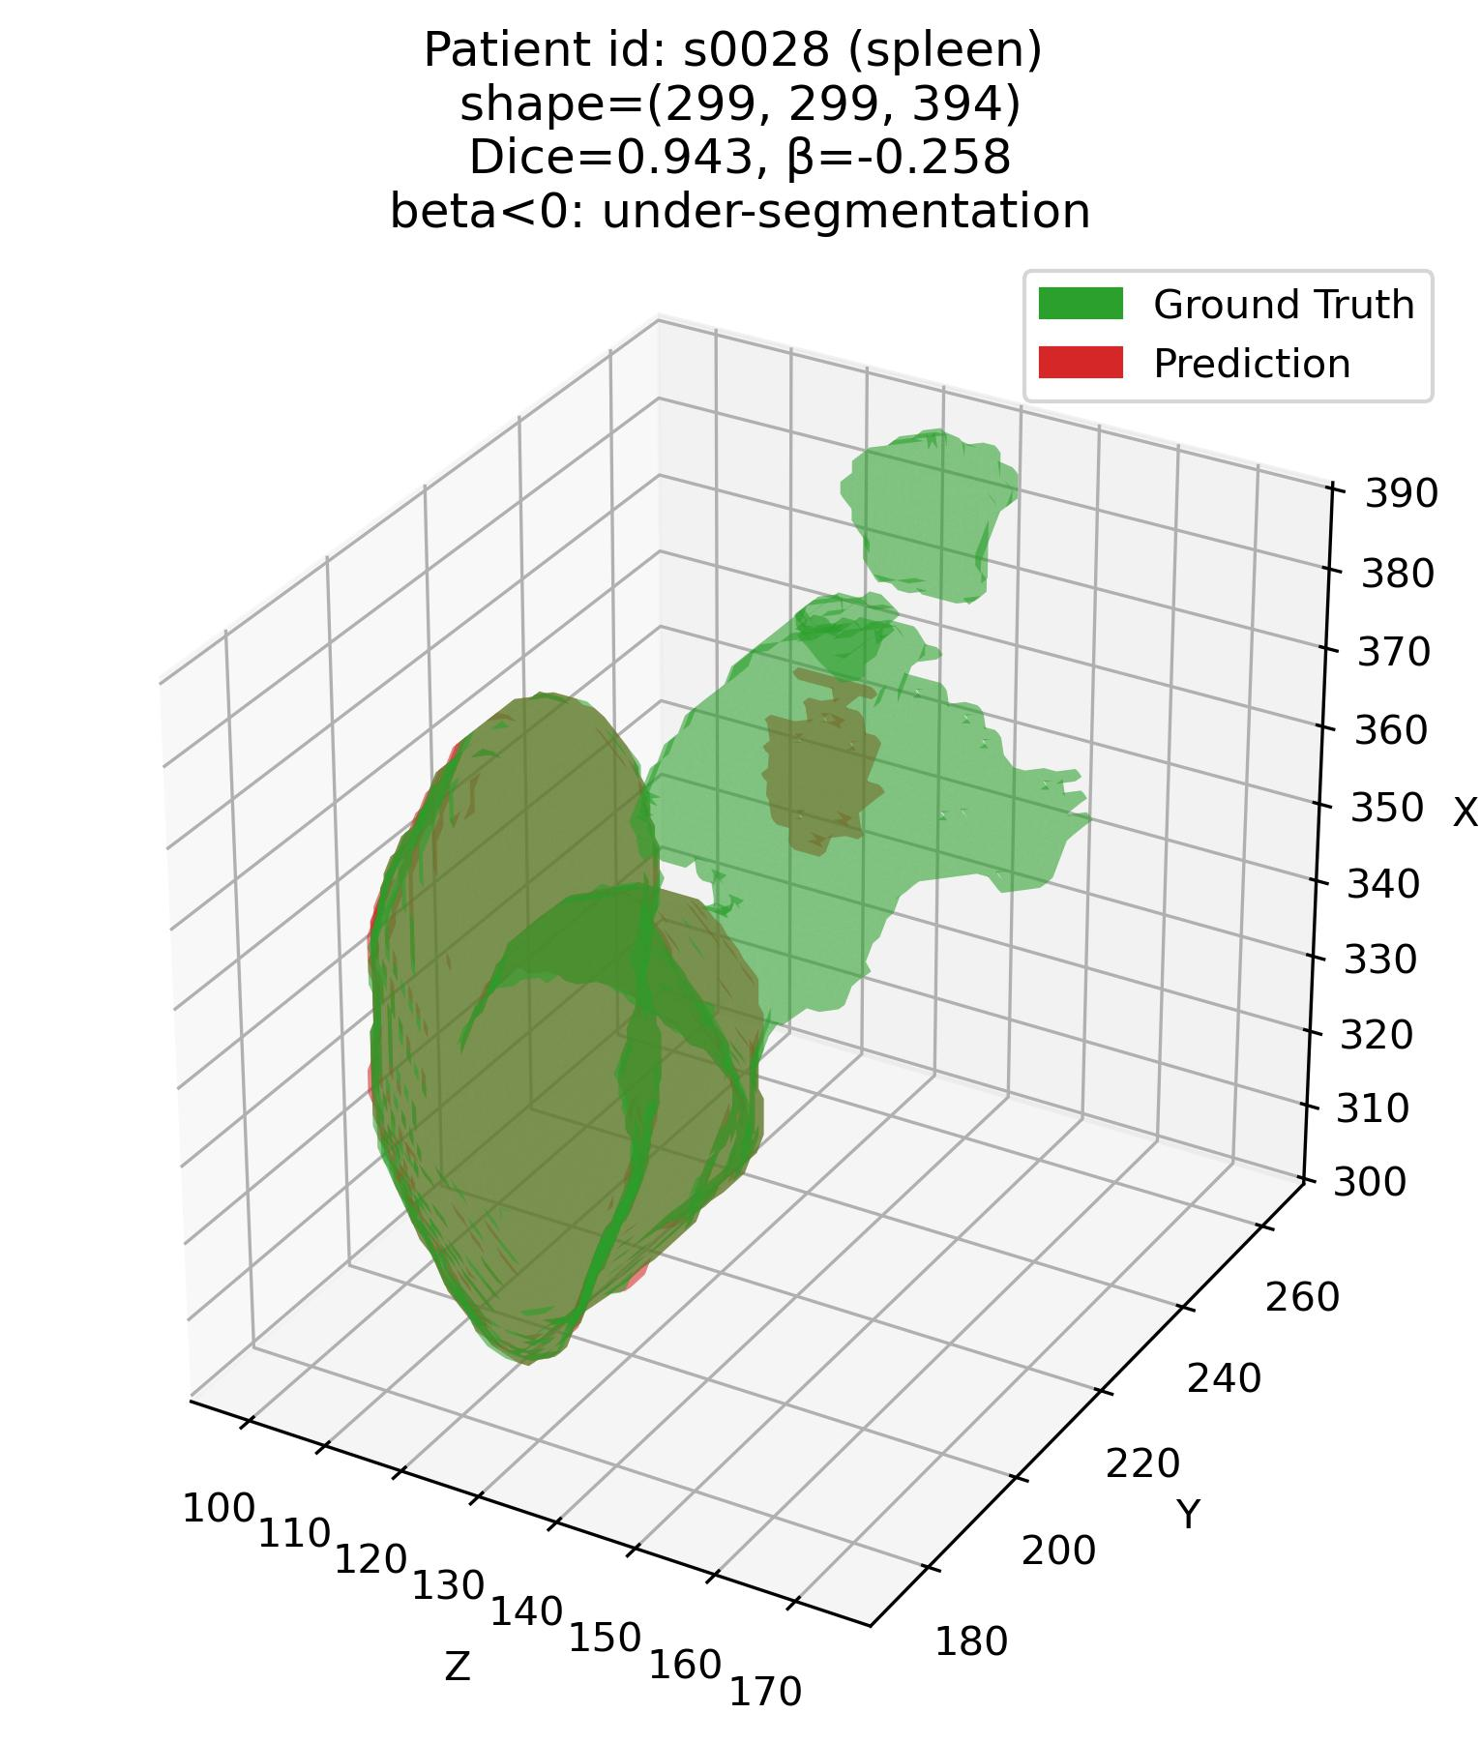
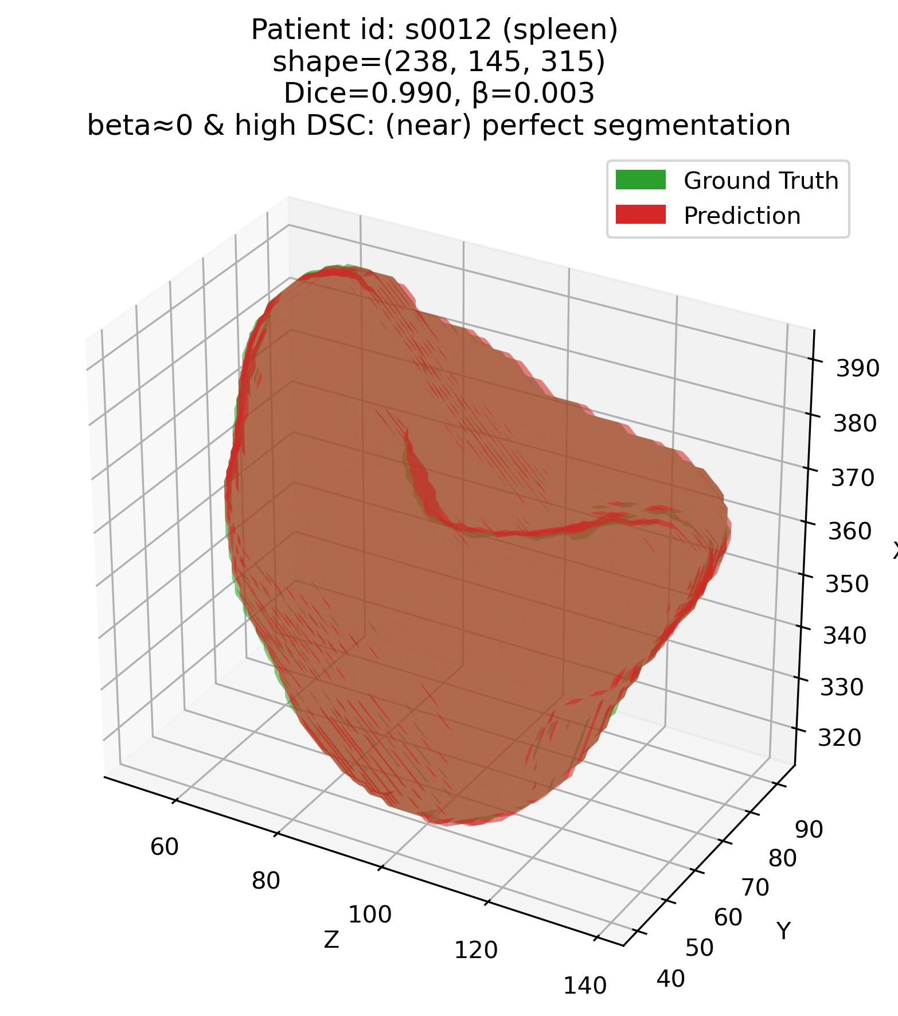
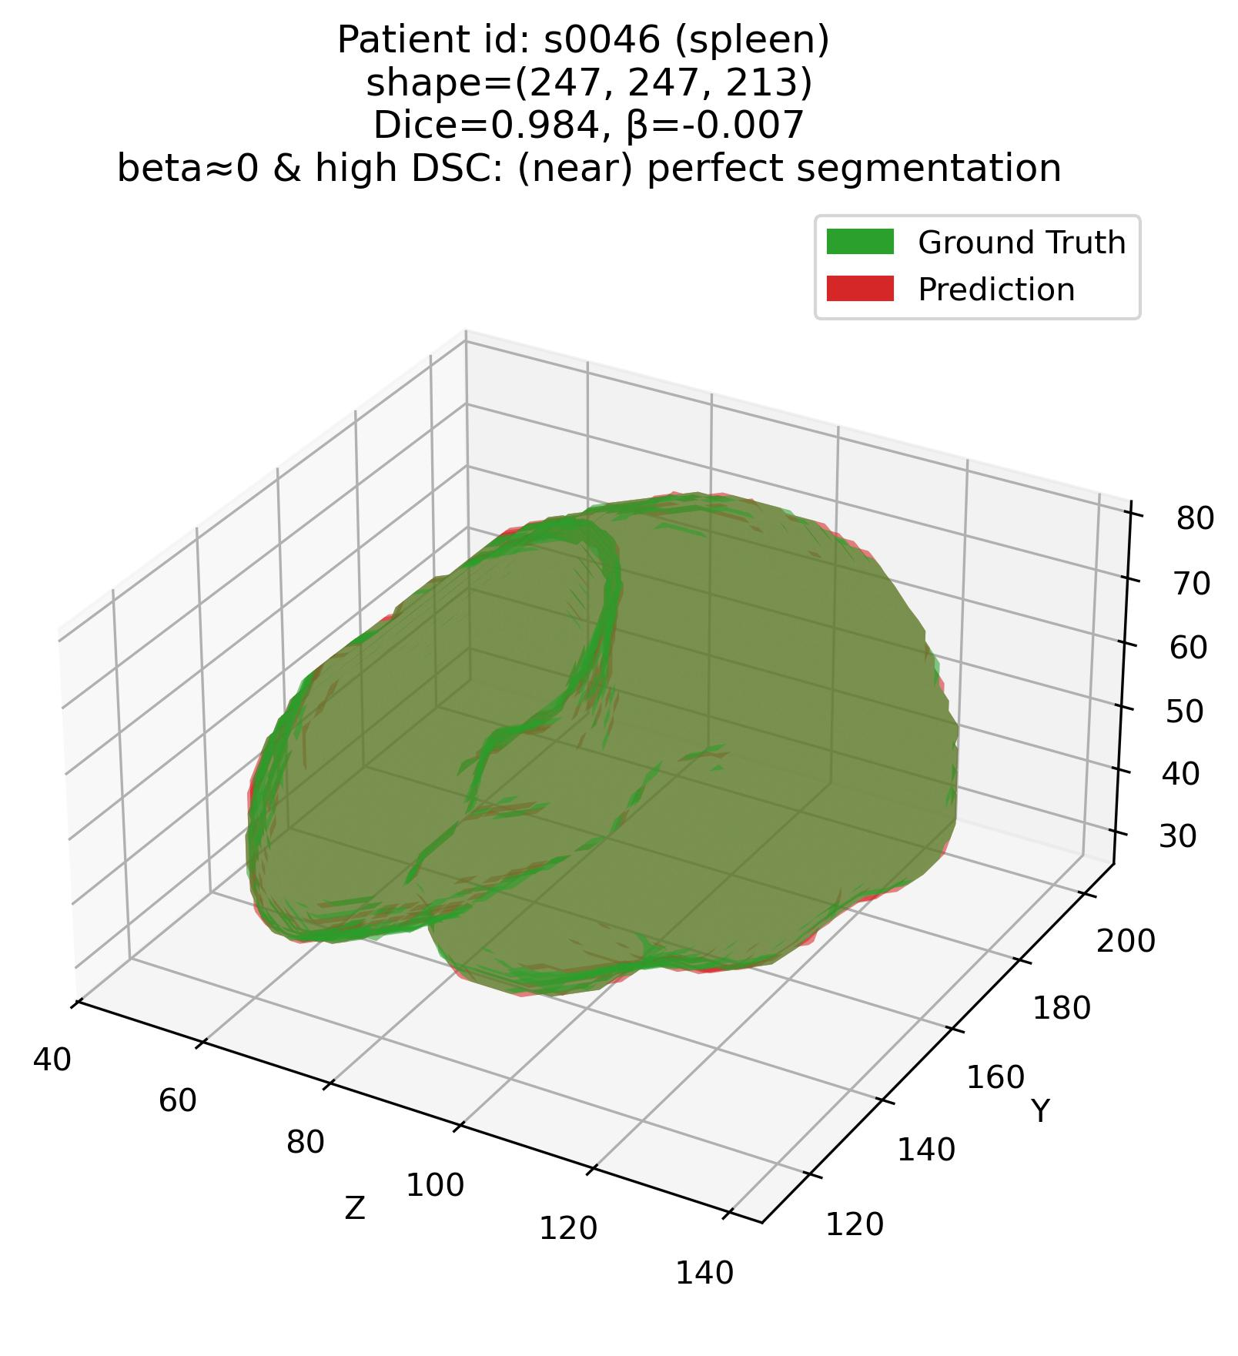
Results 1 – Visual
Efficacy of the joint $β−DSC$ framework
Q1: Some examples – 2. Spleen (Easy – high DSC organ)

Slide 14
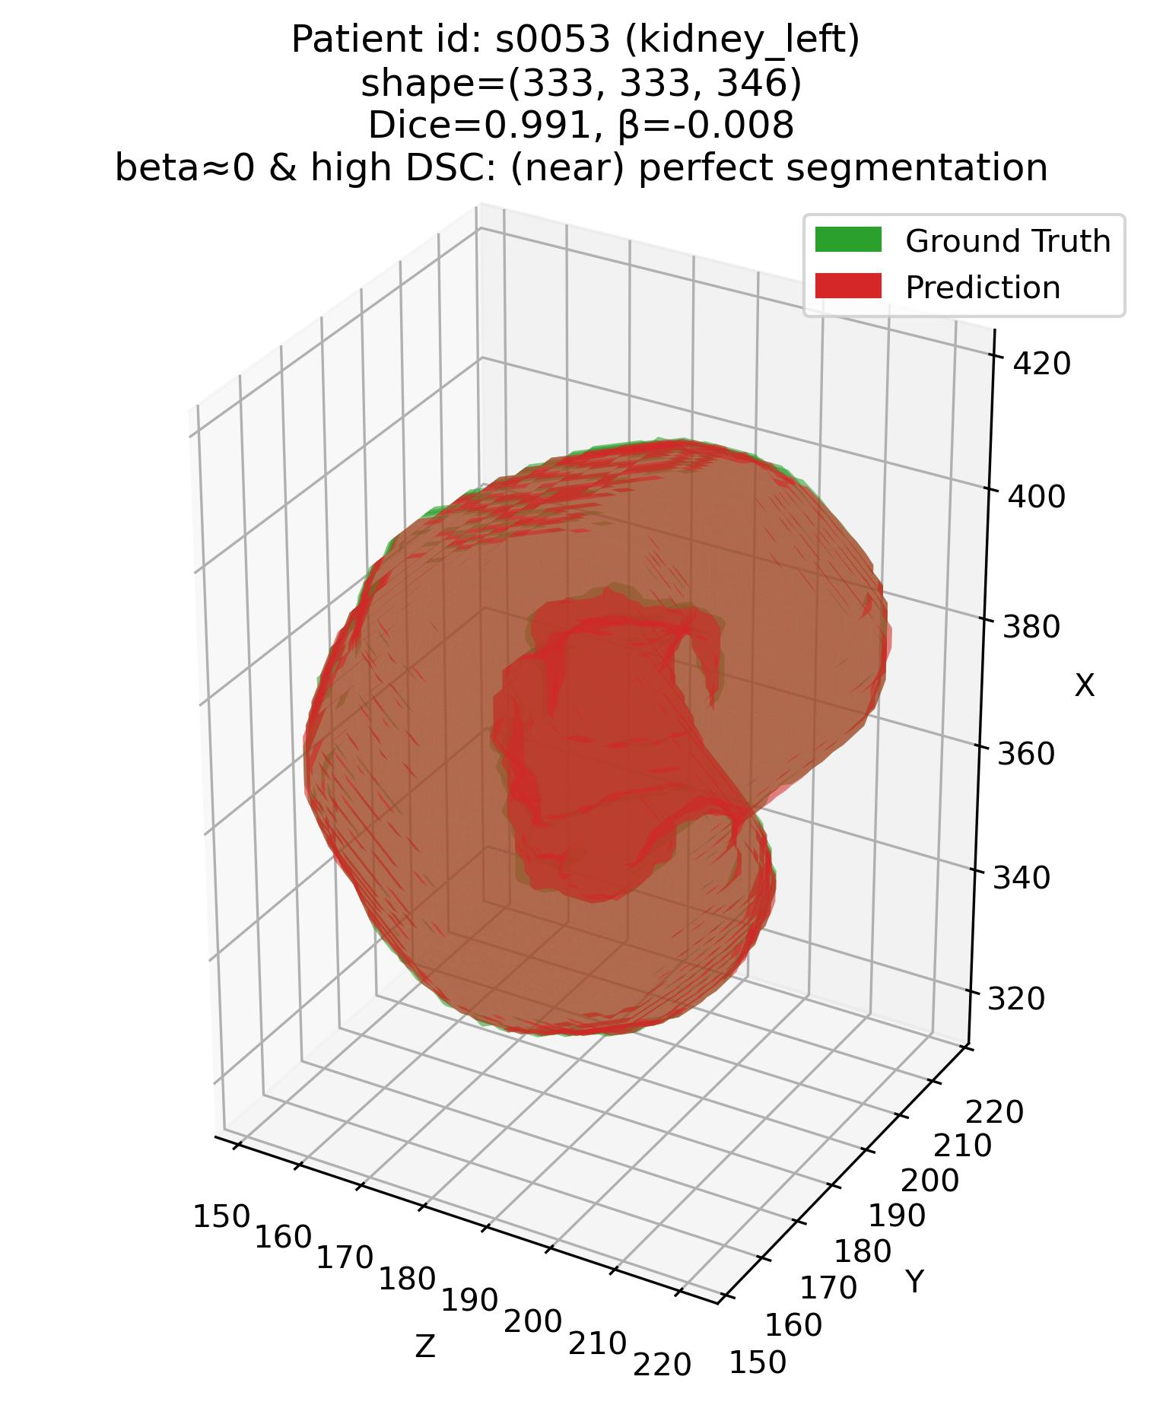
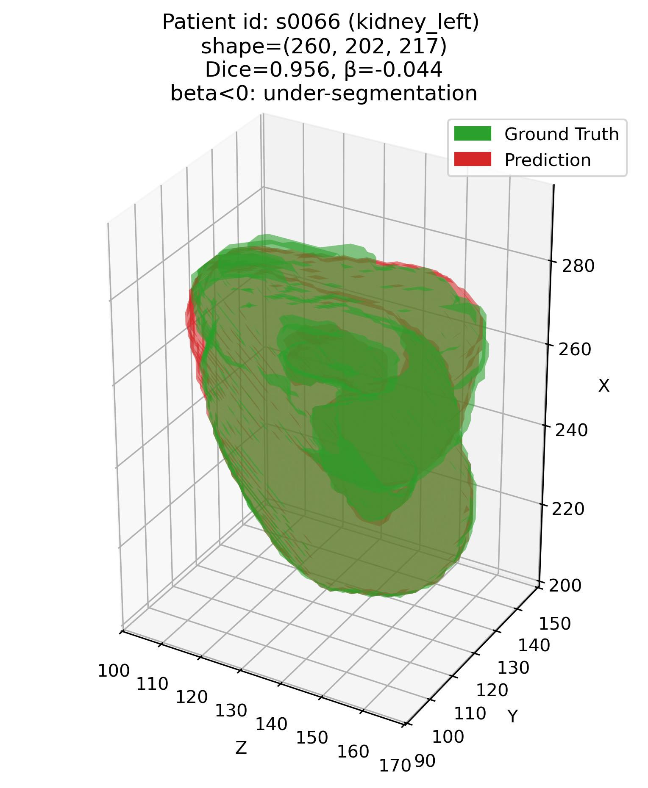
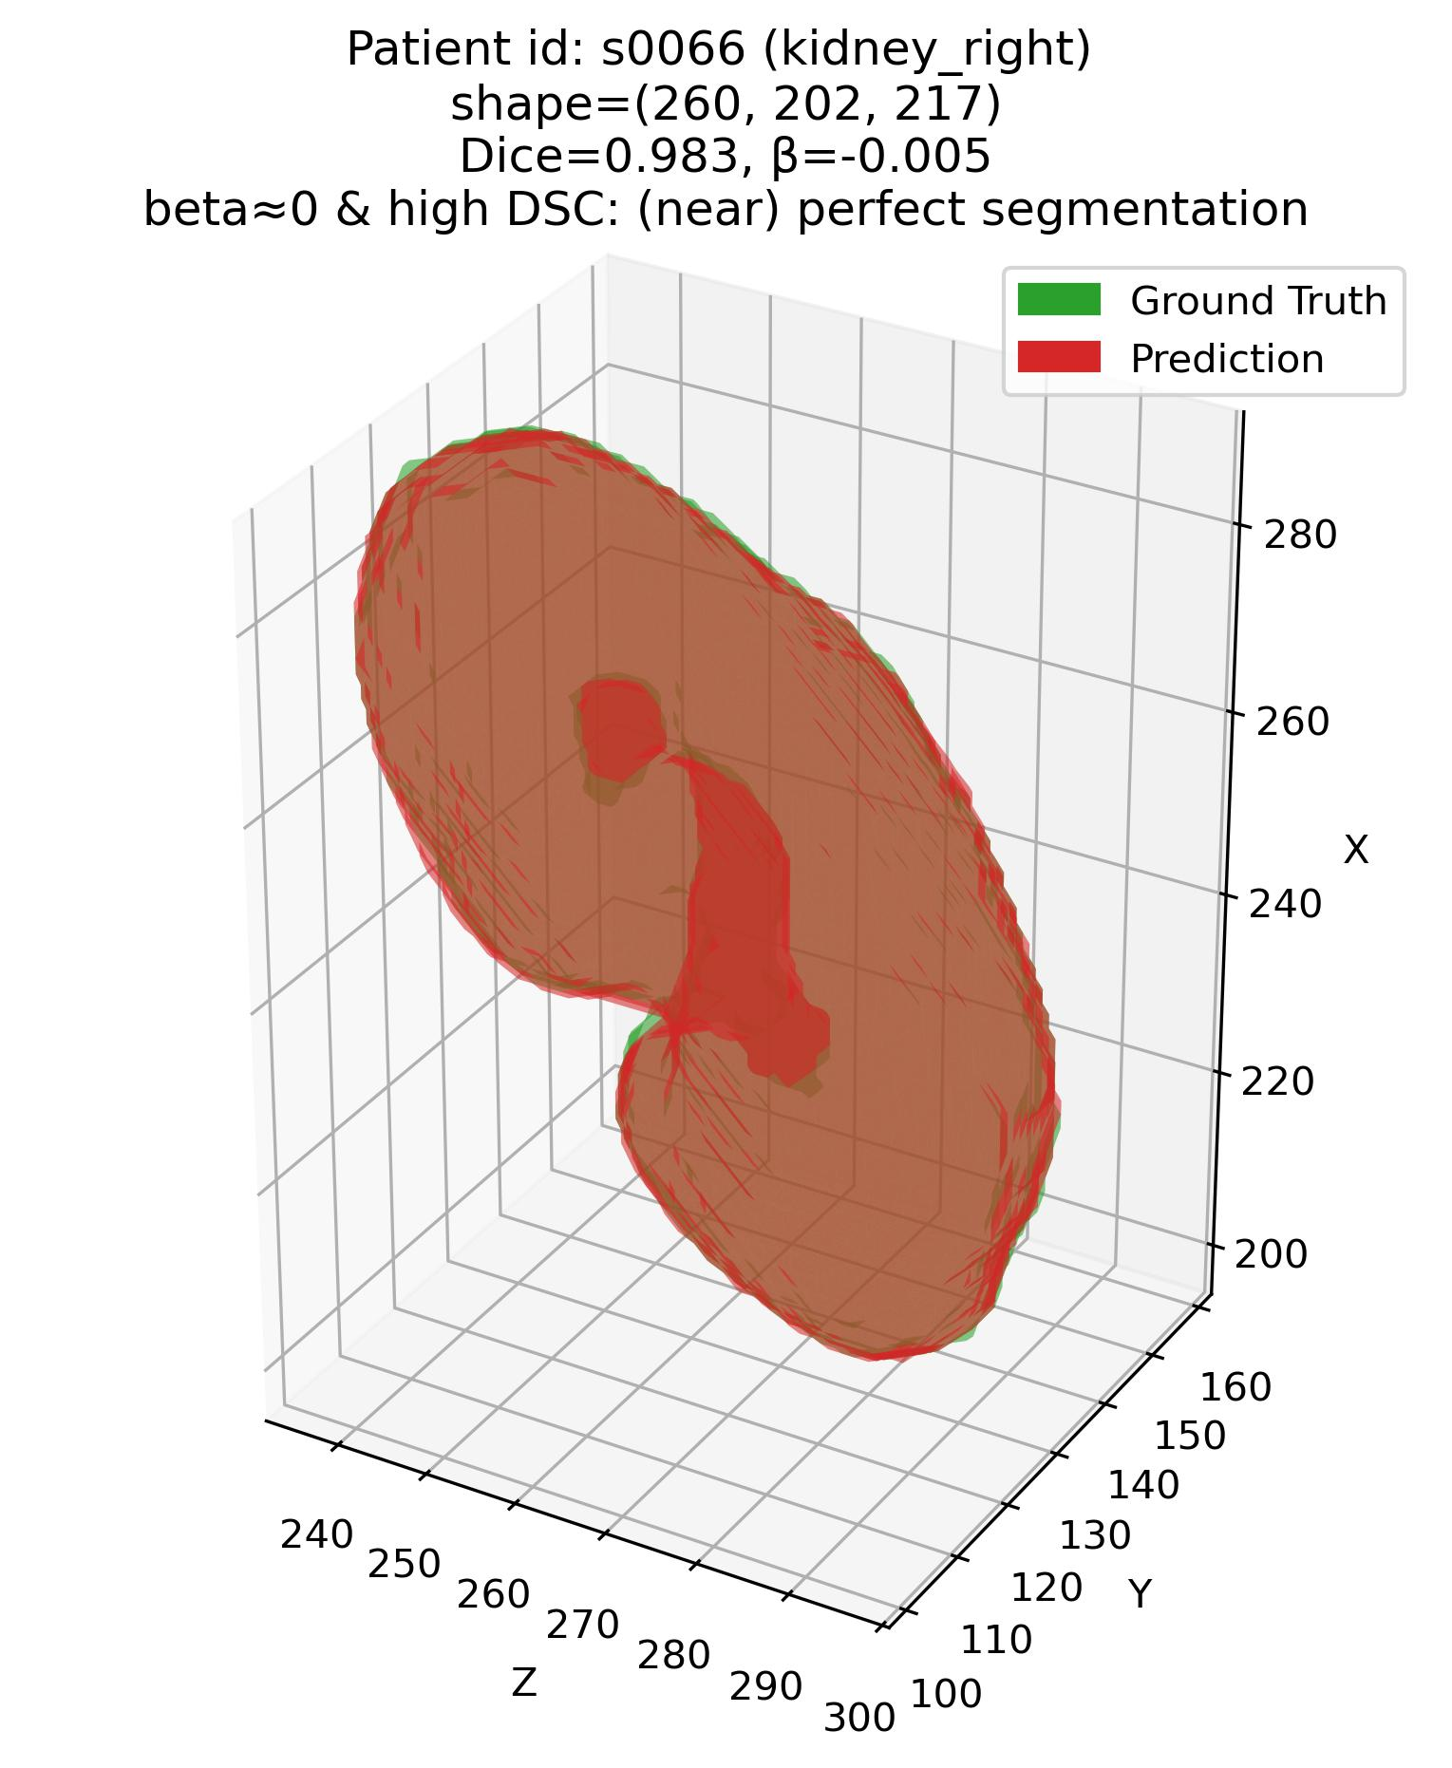
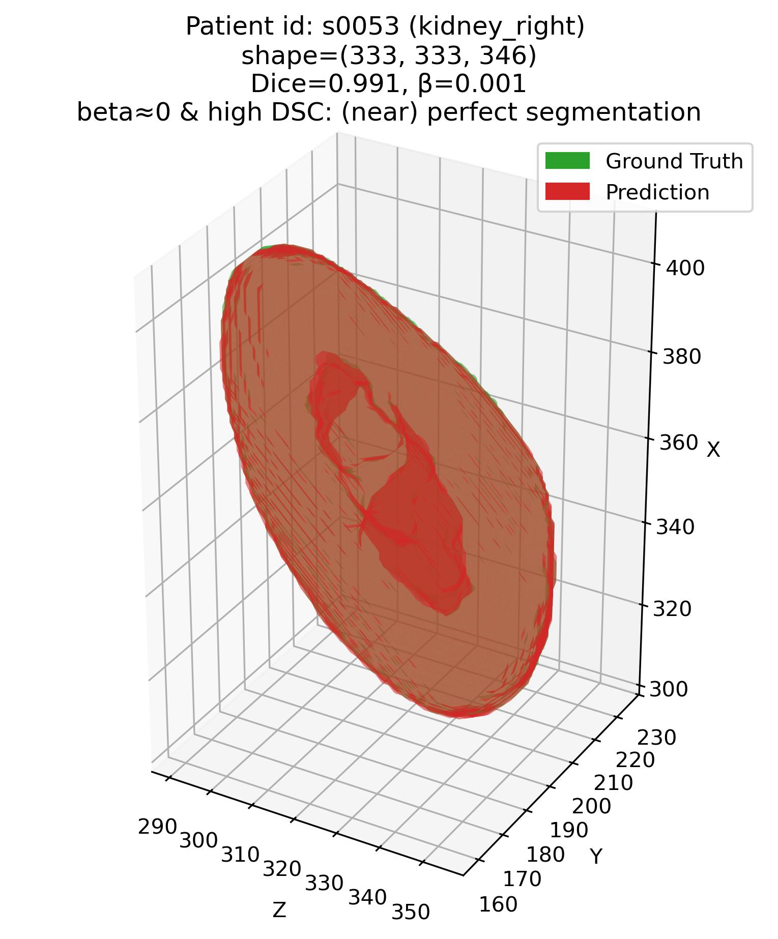
Results 1 – Visual
Efficacy of the joint $β−DSC$ framework
Q1: Some examples – 3. Kidneys (Easy – high DSC organ)
Patient# s0053 (Kidneys)
Patient# s0066 (Kidneys)

Slide 15
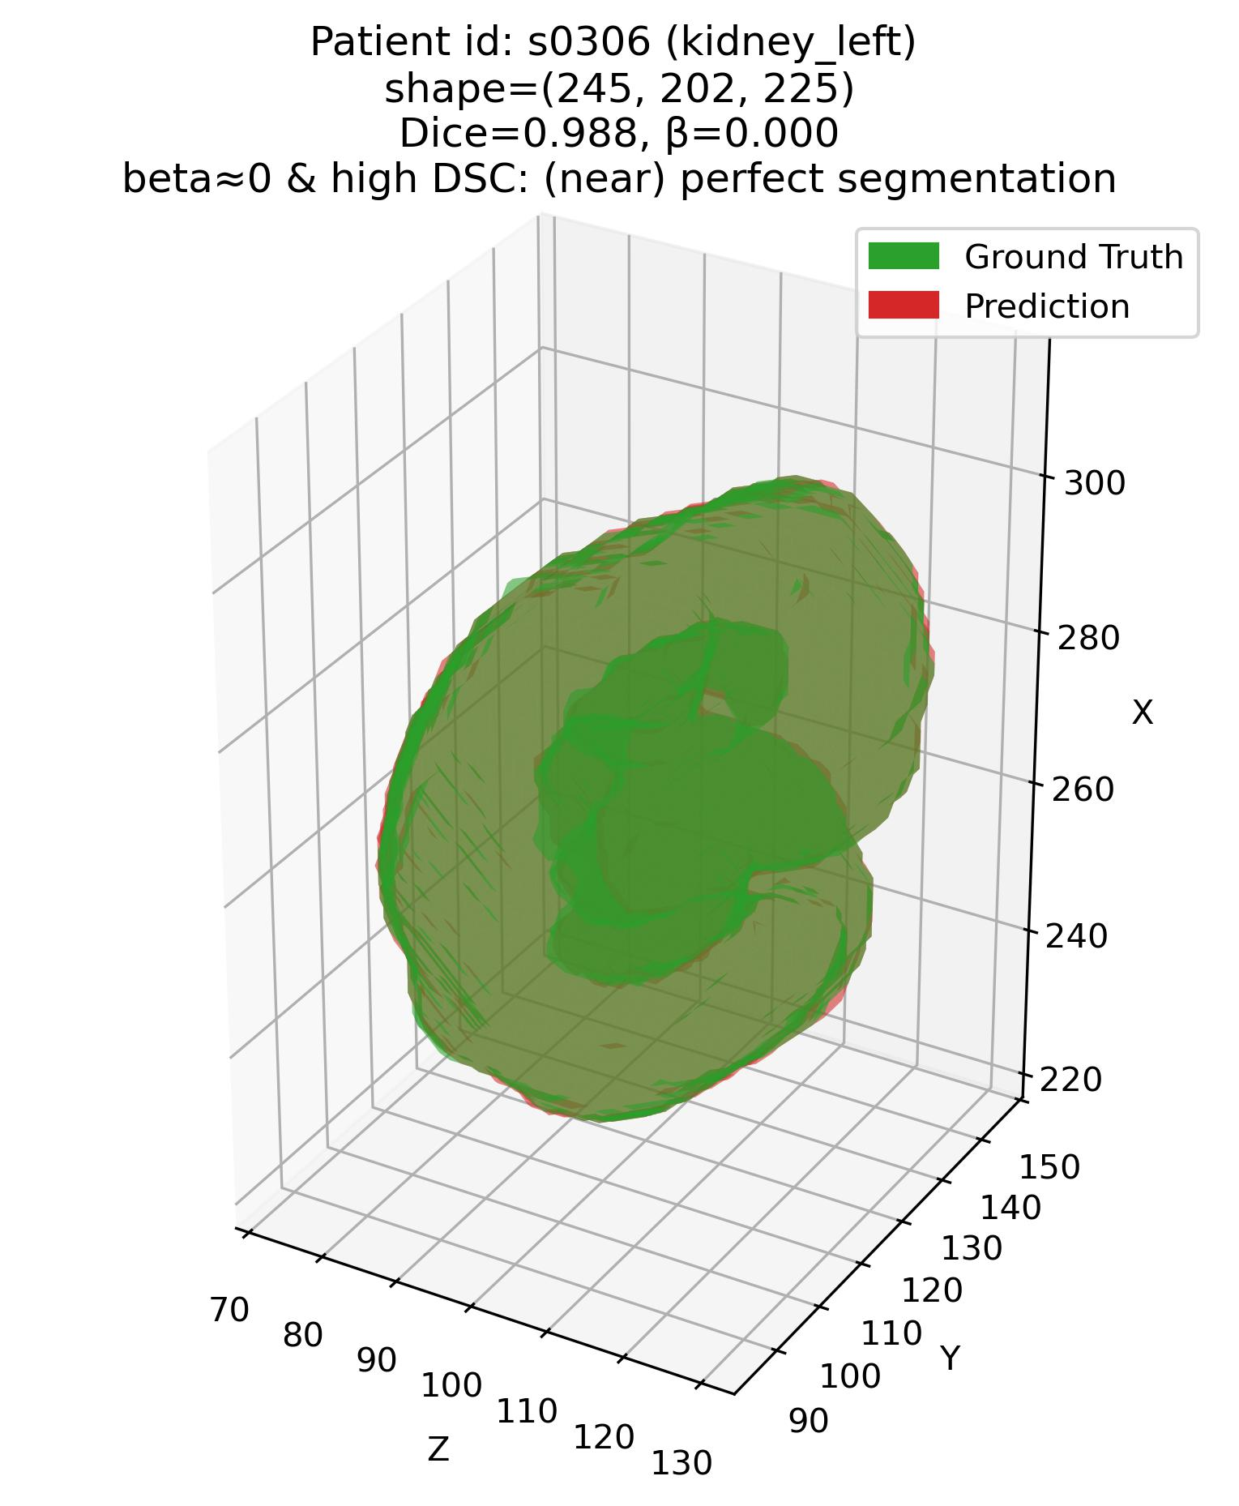
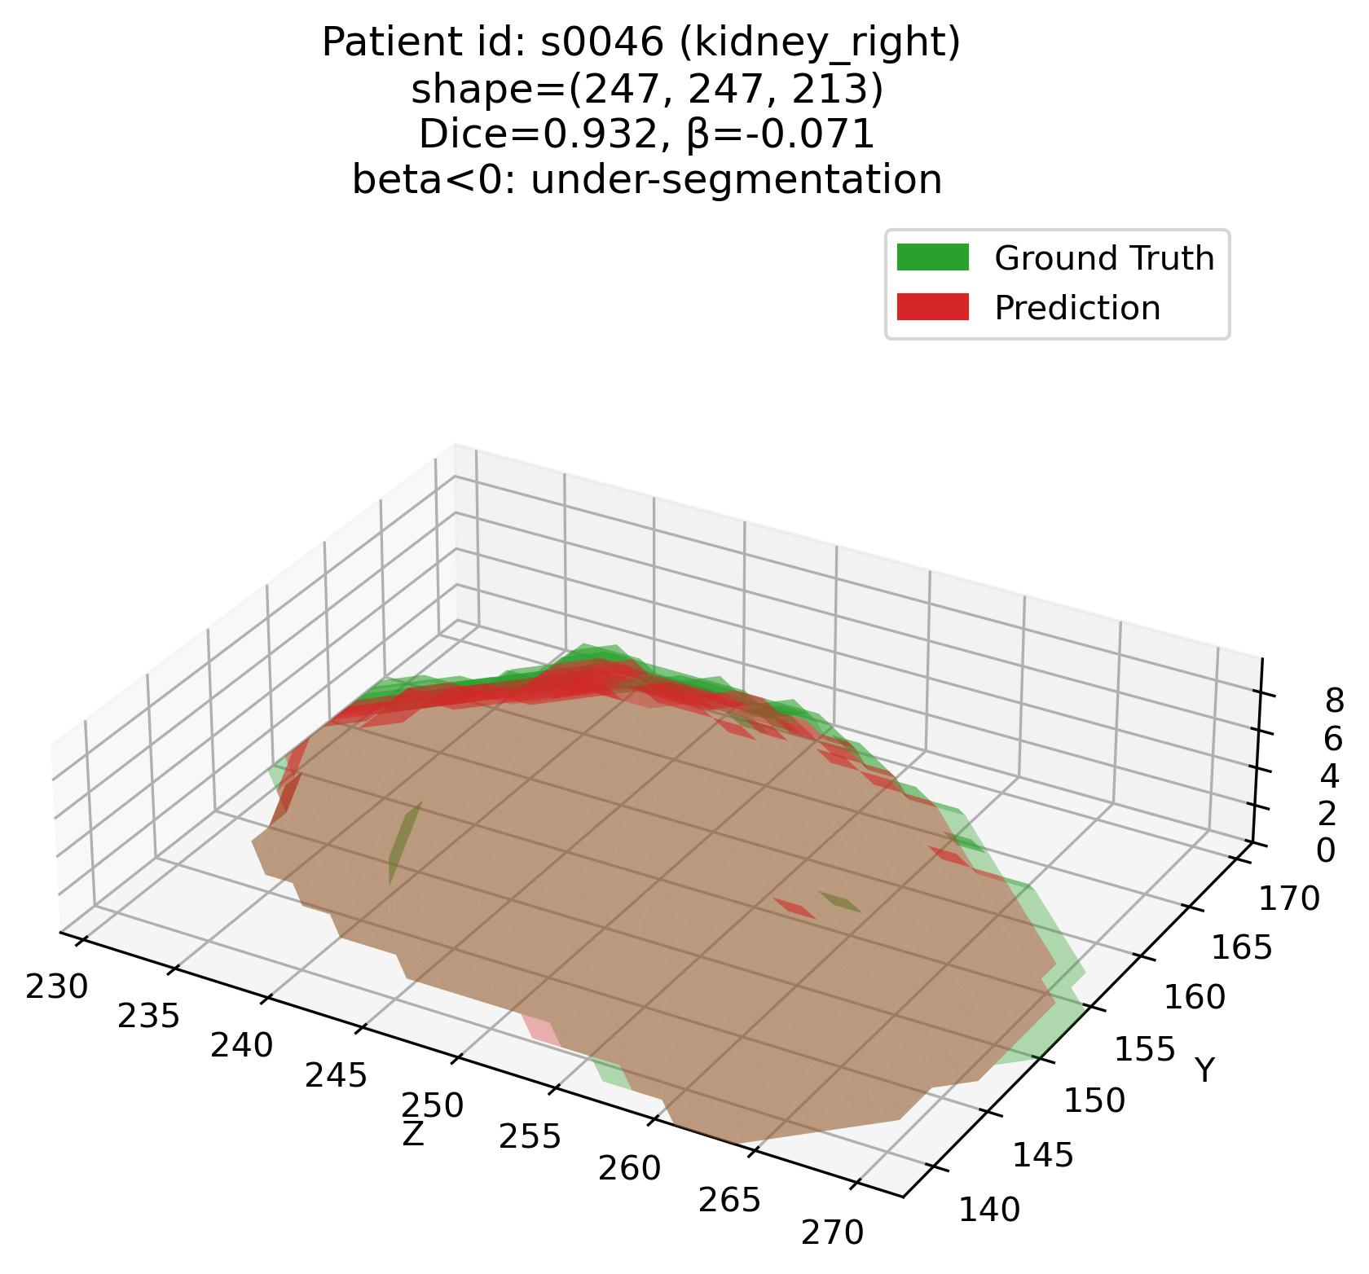
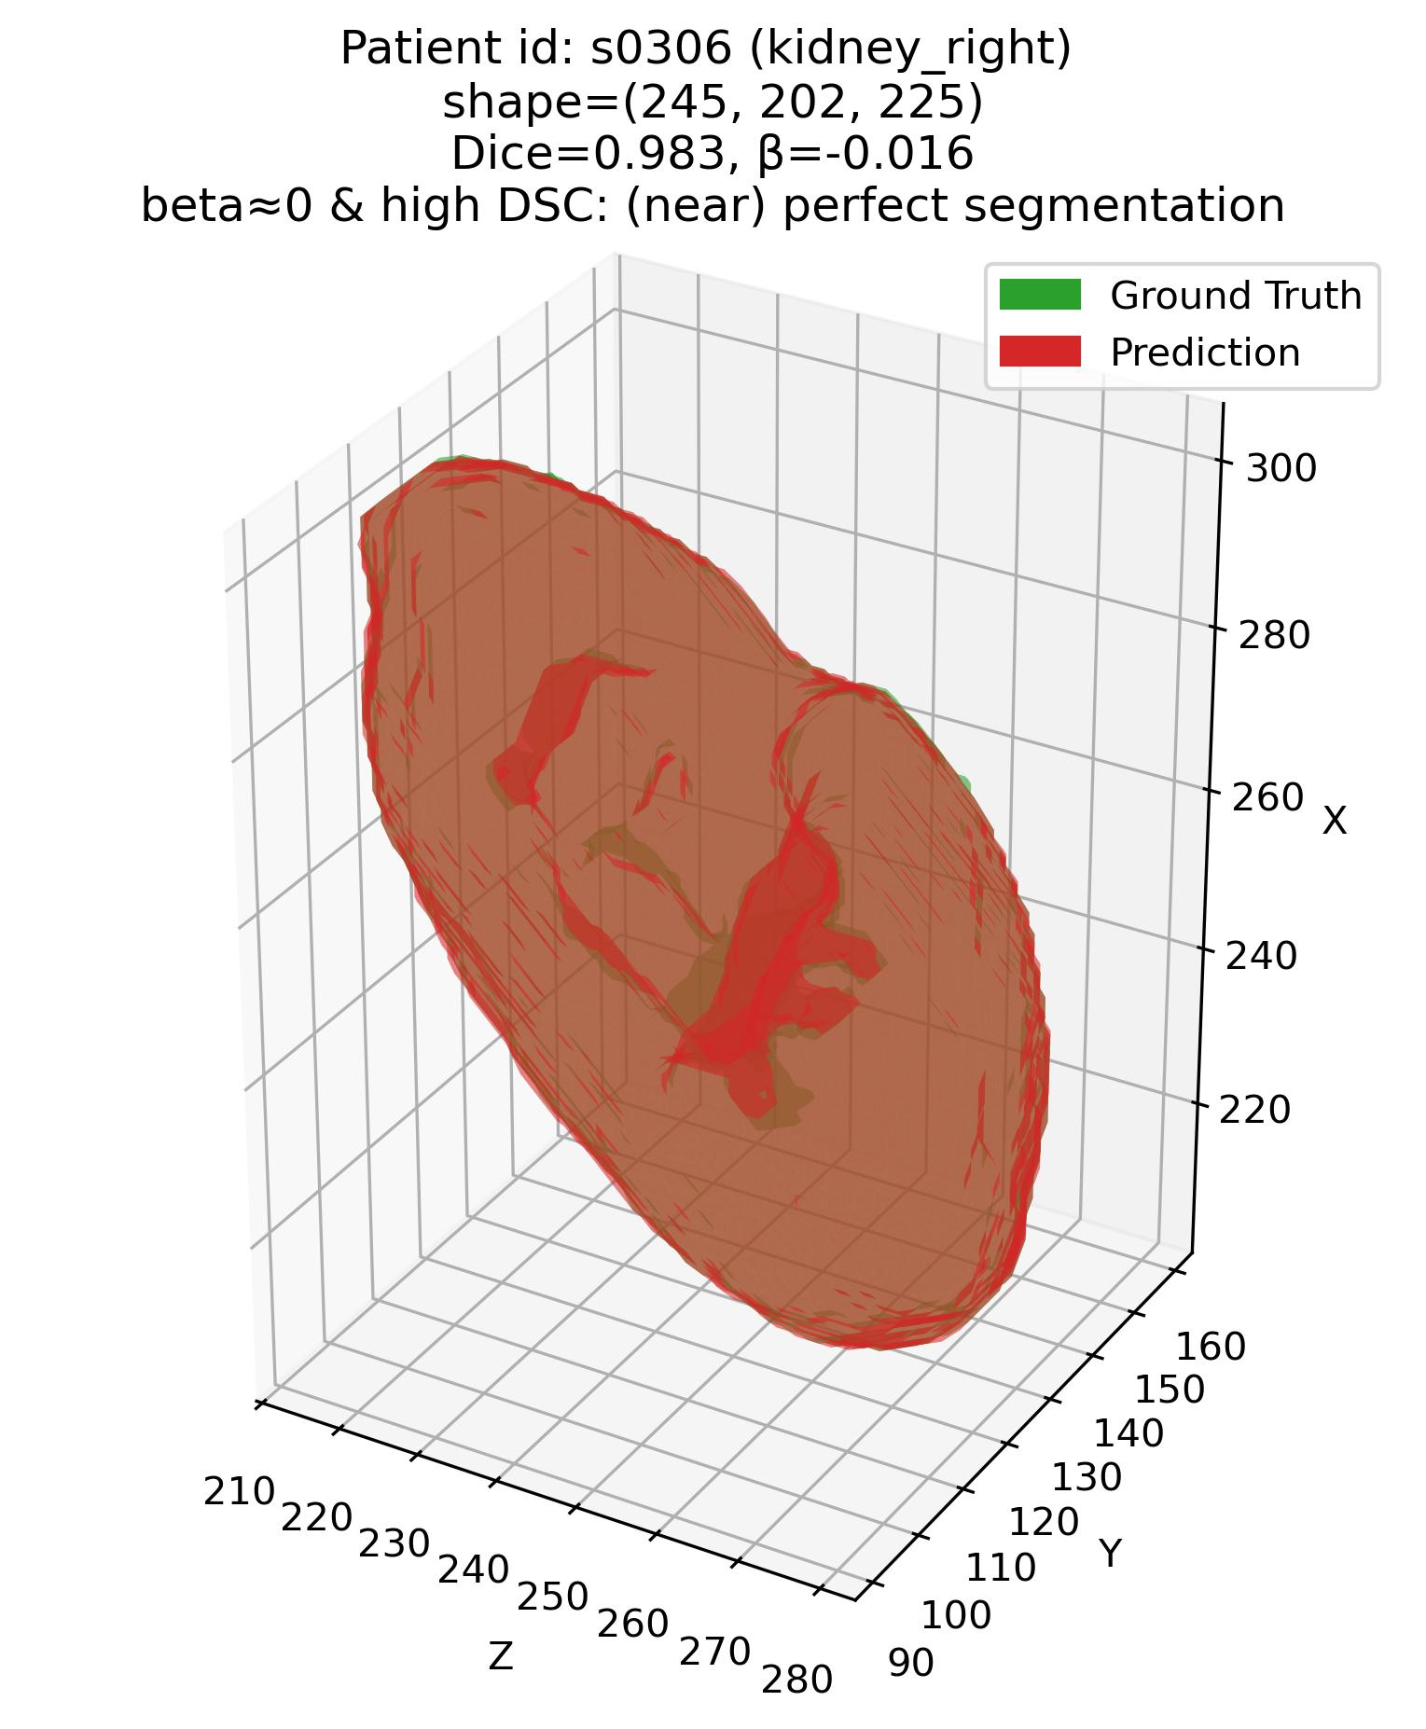
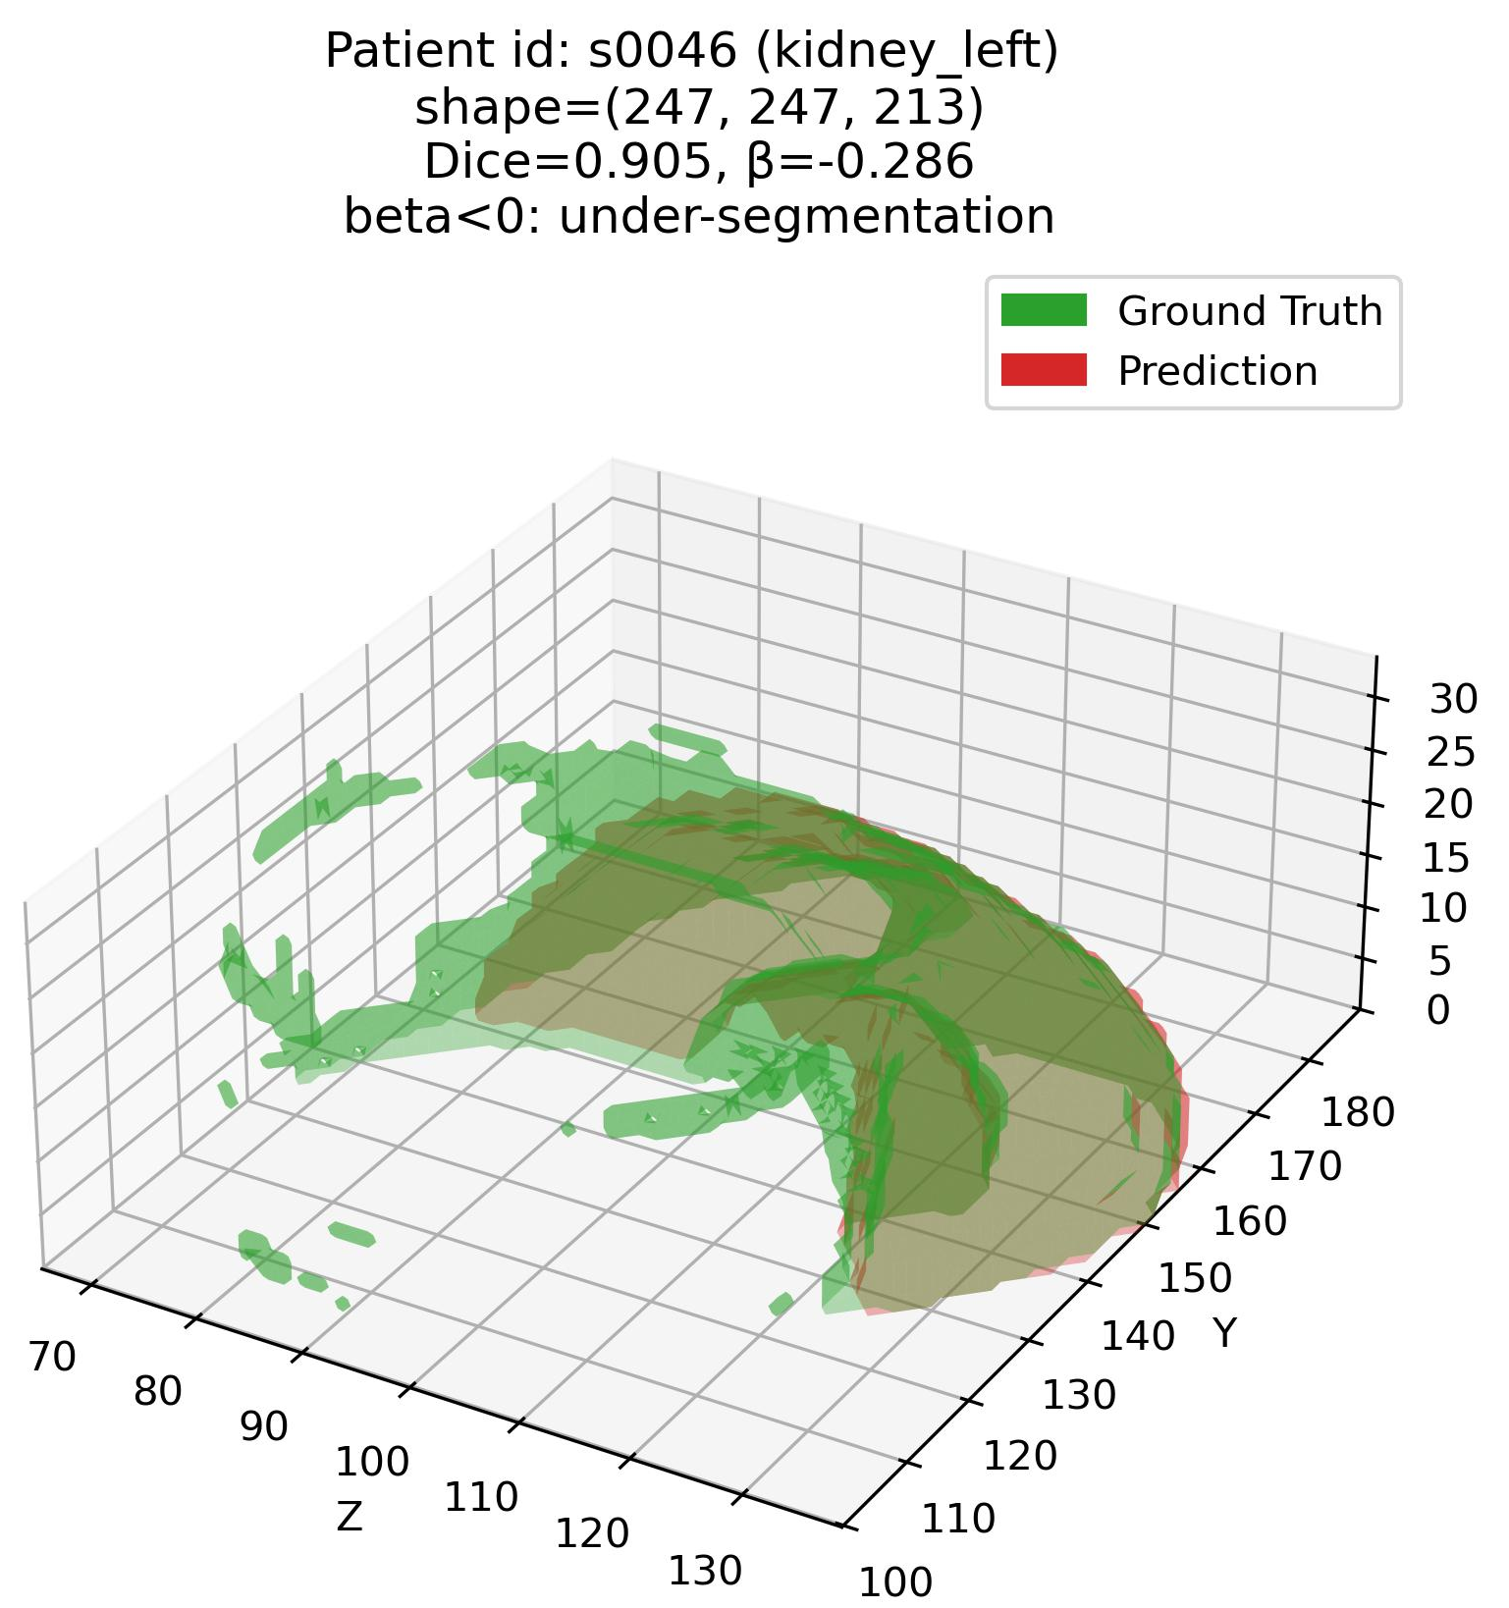
Results 1 – Visual
Efficacy of the joint $β−DSC$ framework
Q1: Some examples – 3. Kidneys (Easy – high DSC organ)
Patient# s0306 (Kidneys)
Patient# s0046 (Kidneys)

Slide 16
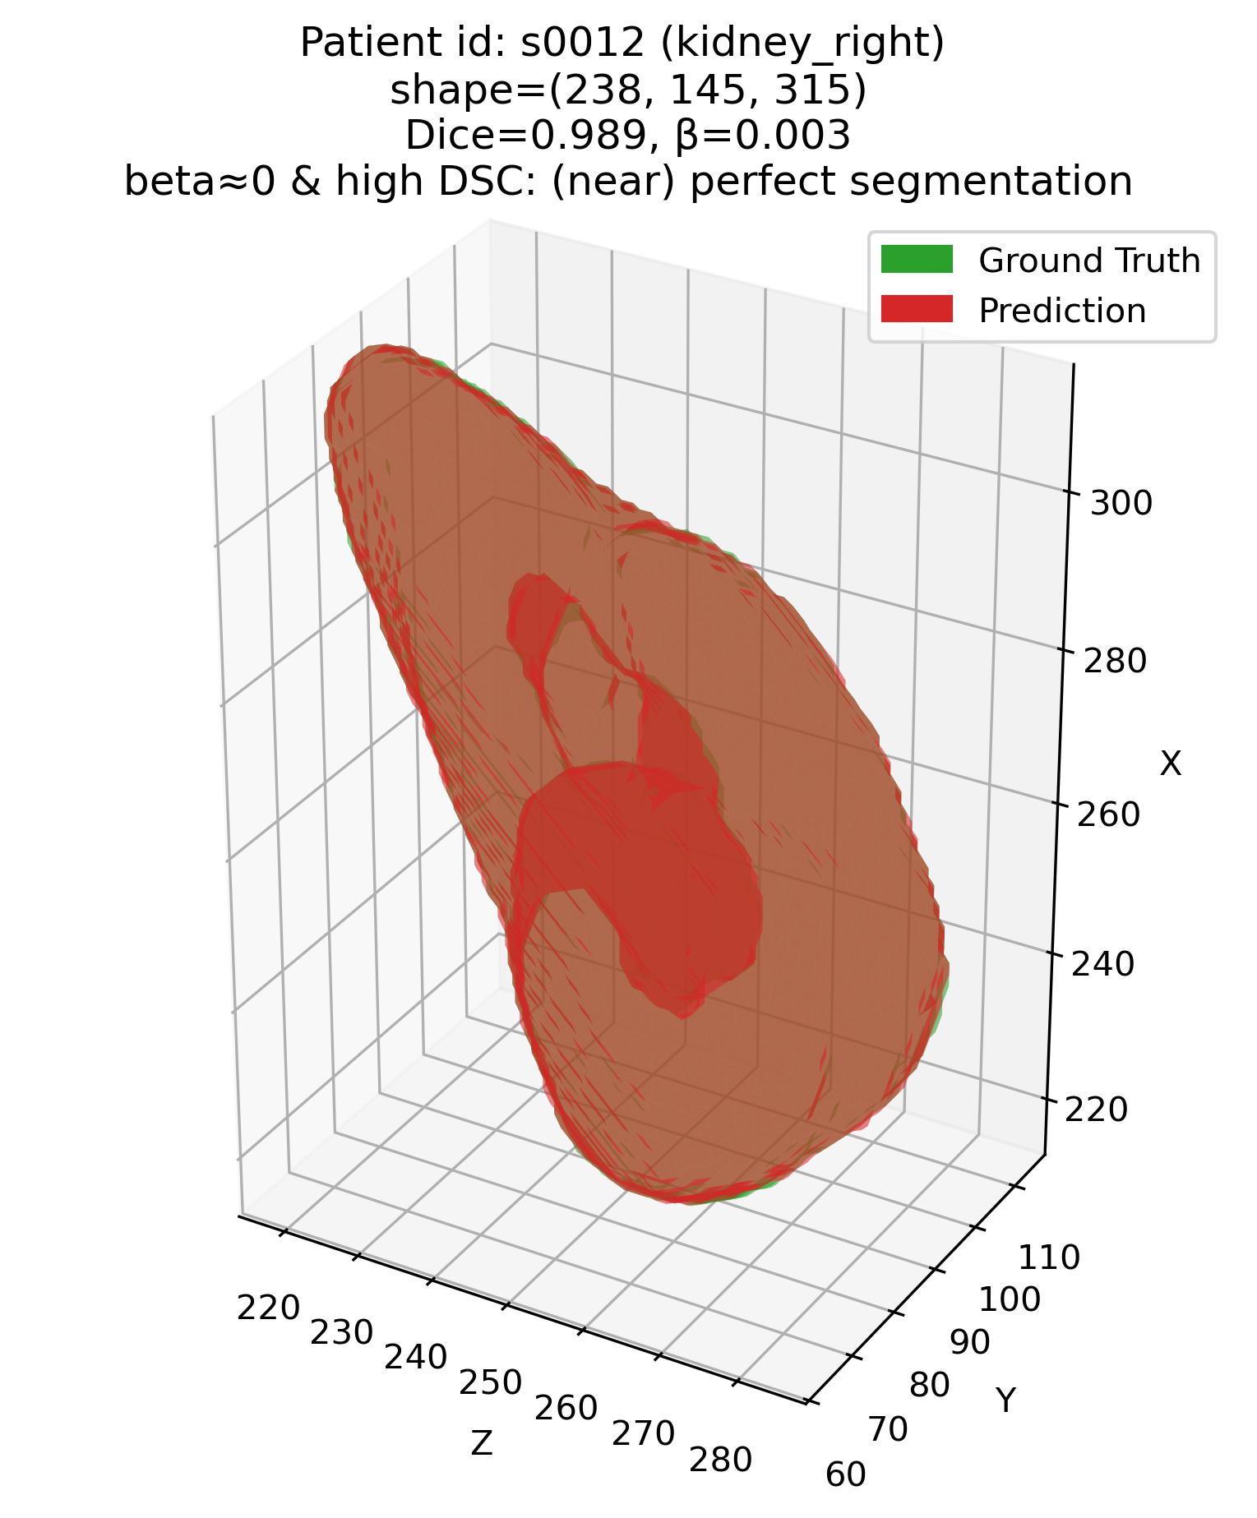
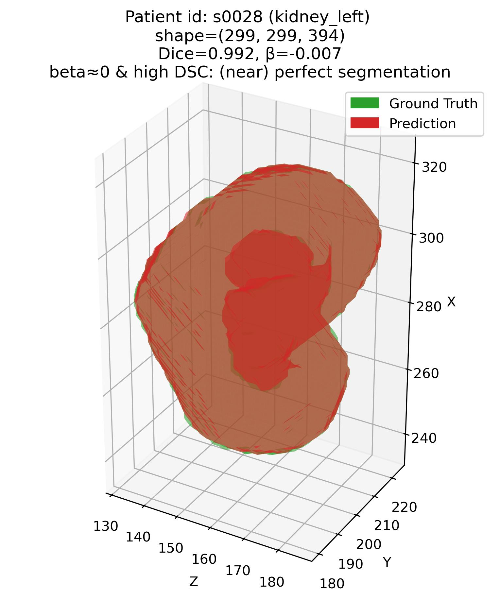
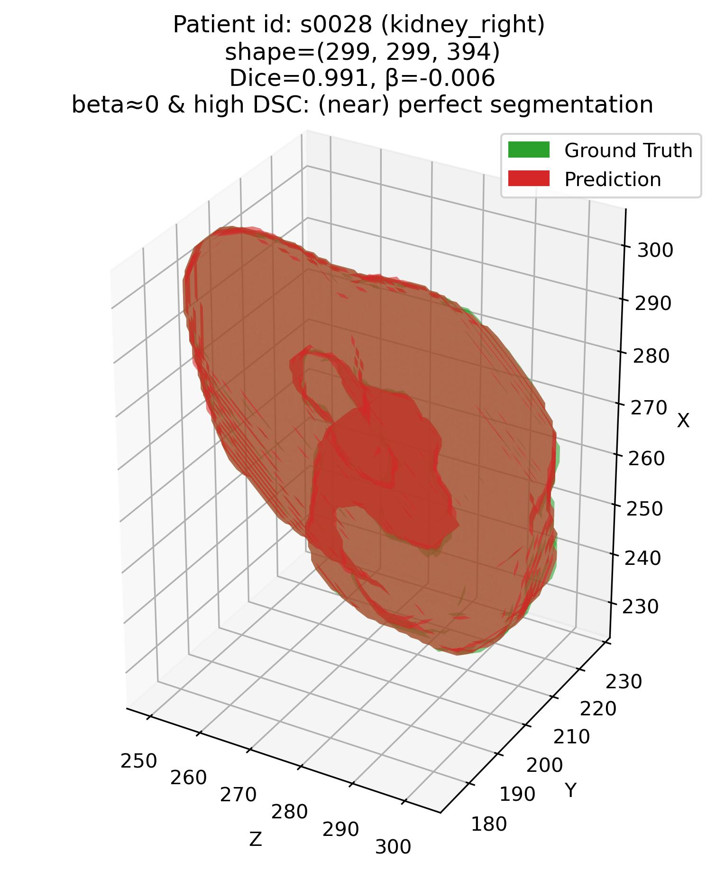
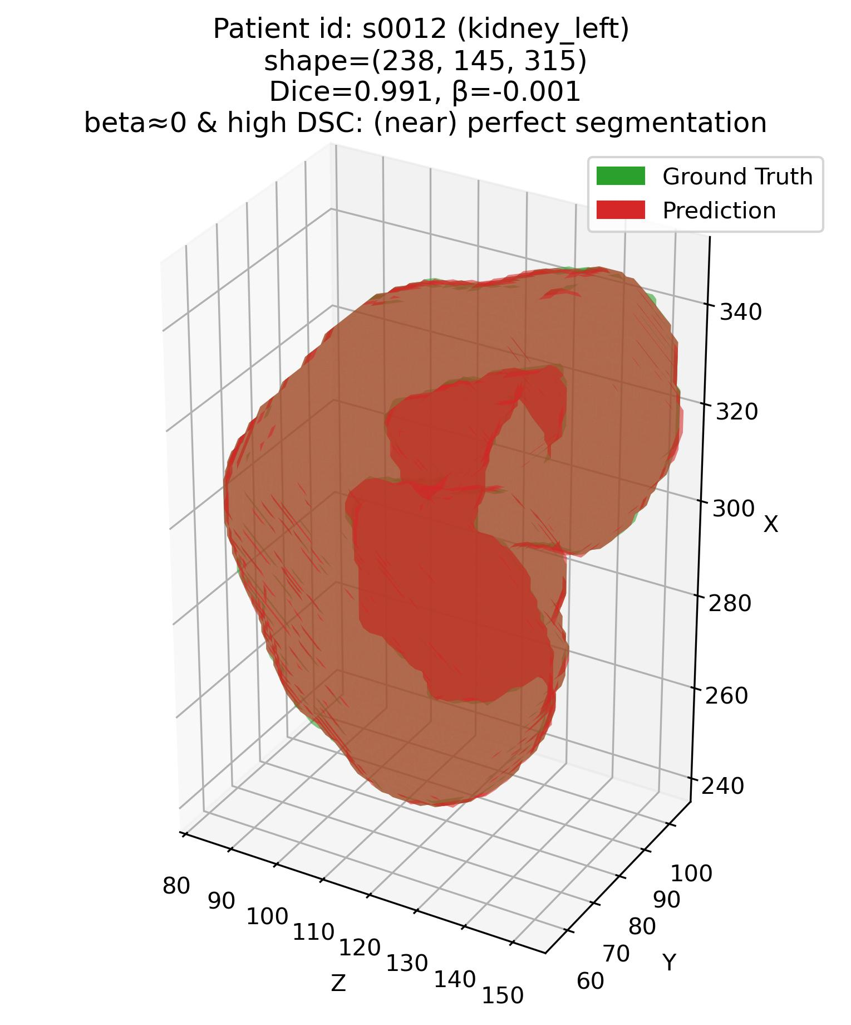
Results 1 – Visual
Efficacy of the joint $β−DSC$ framework
Q1: Some examples – 3. Kidneys (Easy – high DSC organ)
Patient# s0012 (Kidneys)
Patient# s0028 (Kidneys)

Slide 17
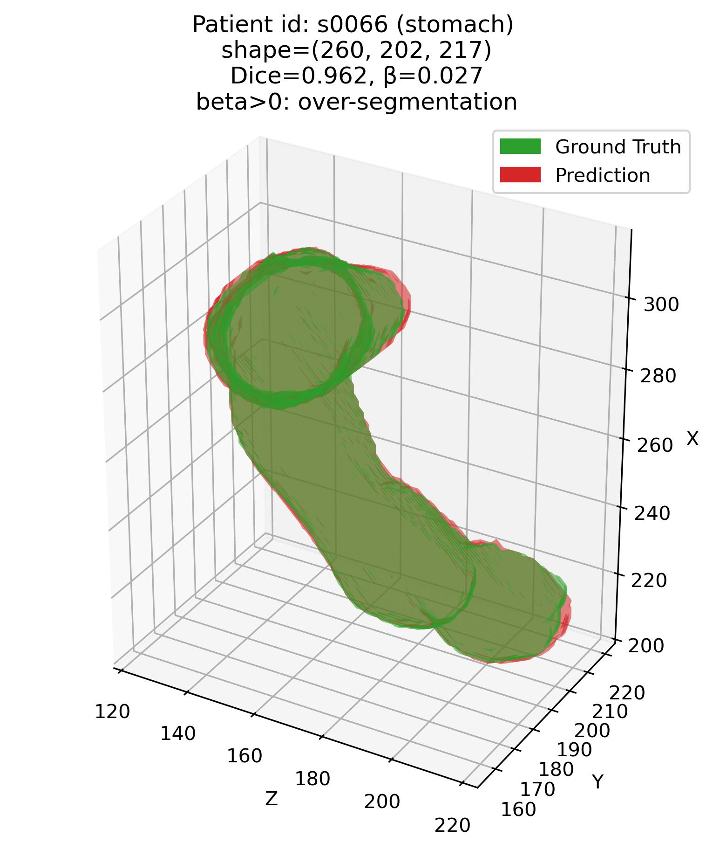
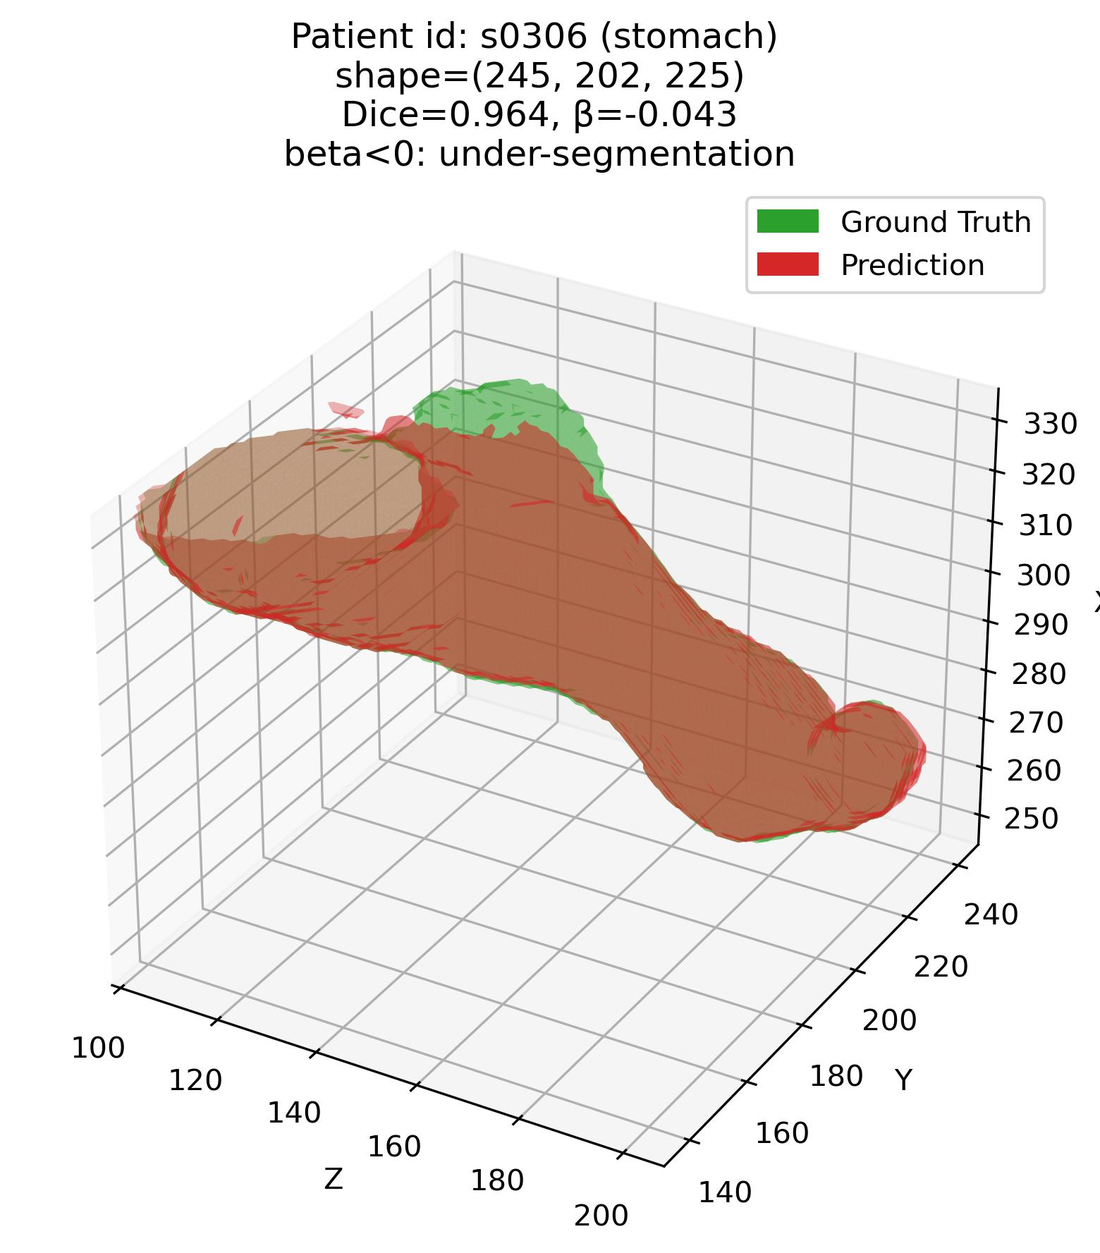
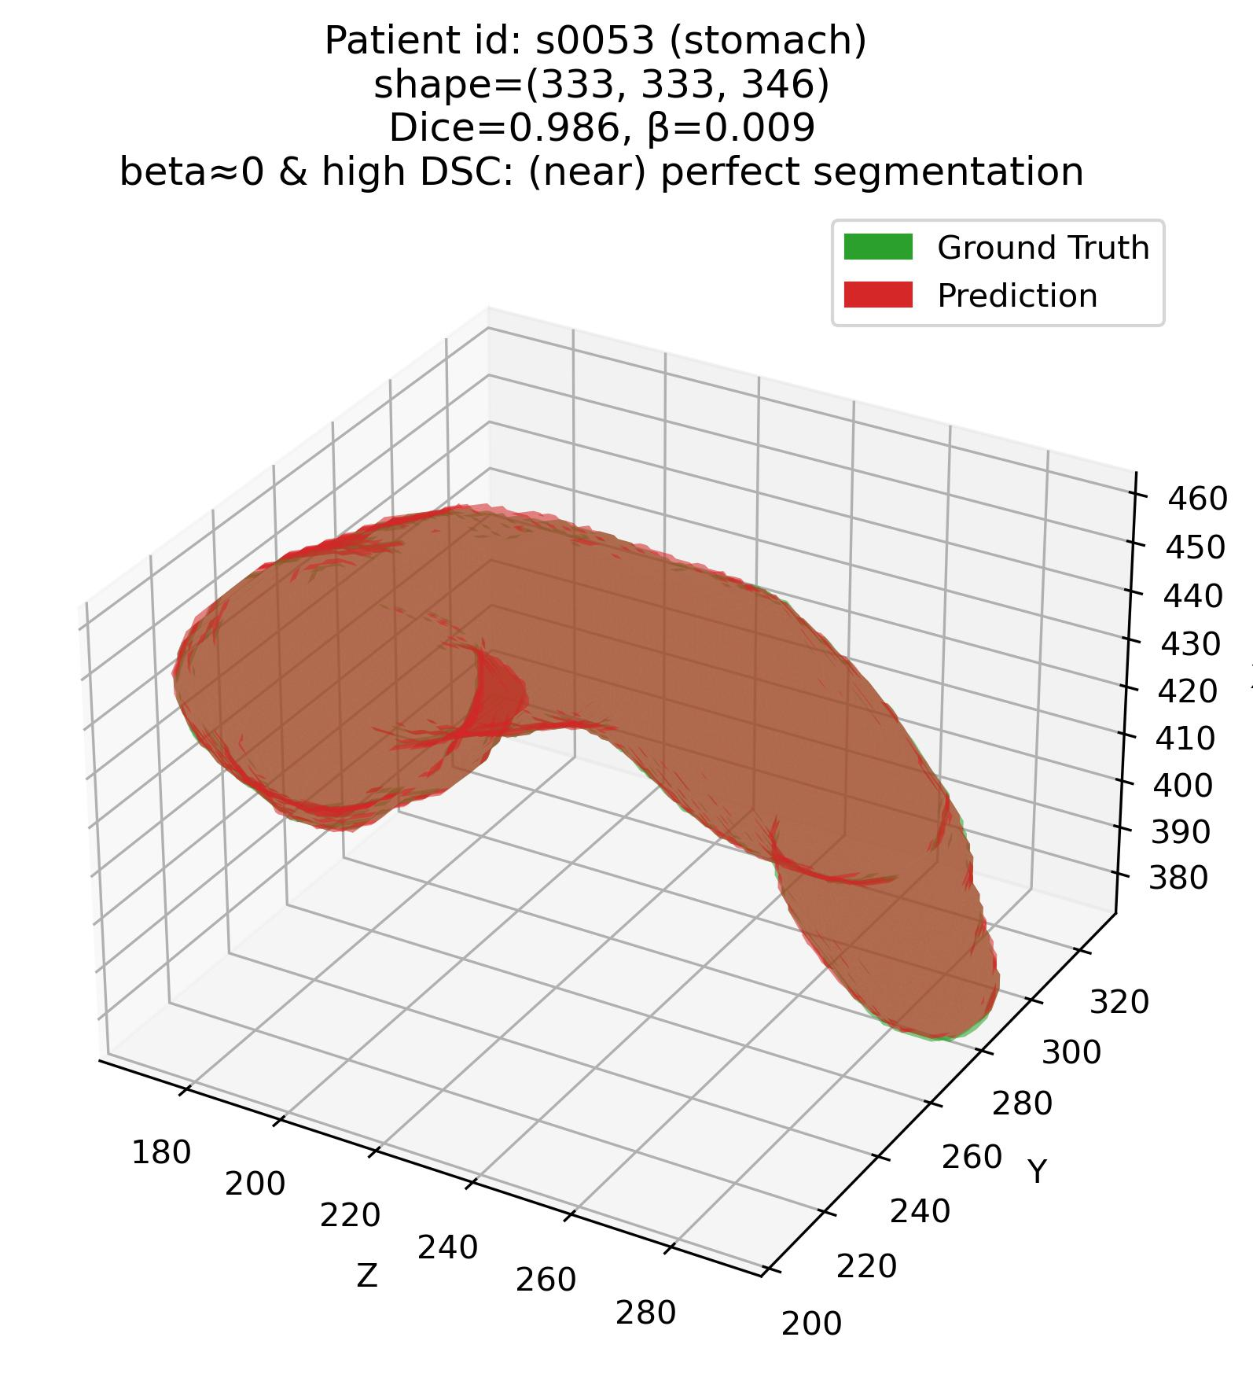
Results 1 – Visual
Efficacy of the joint $β−DSC$ framework
Q1: Some examples – 4. Stomach (Moderate – average DSC organ)

Slide 18
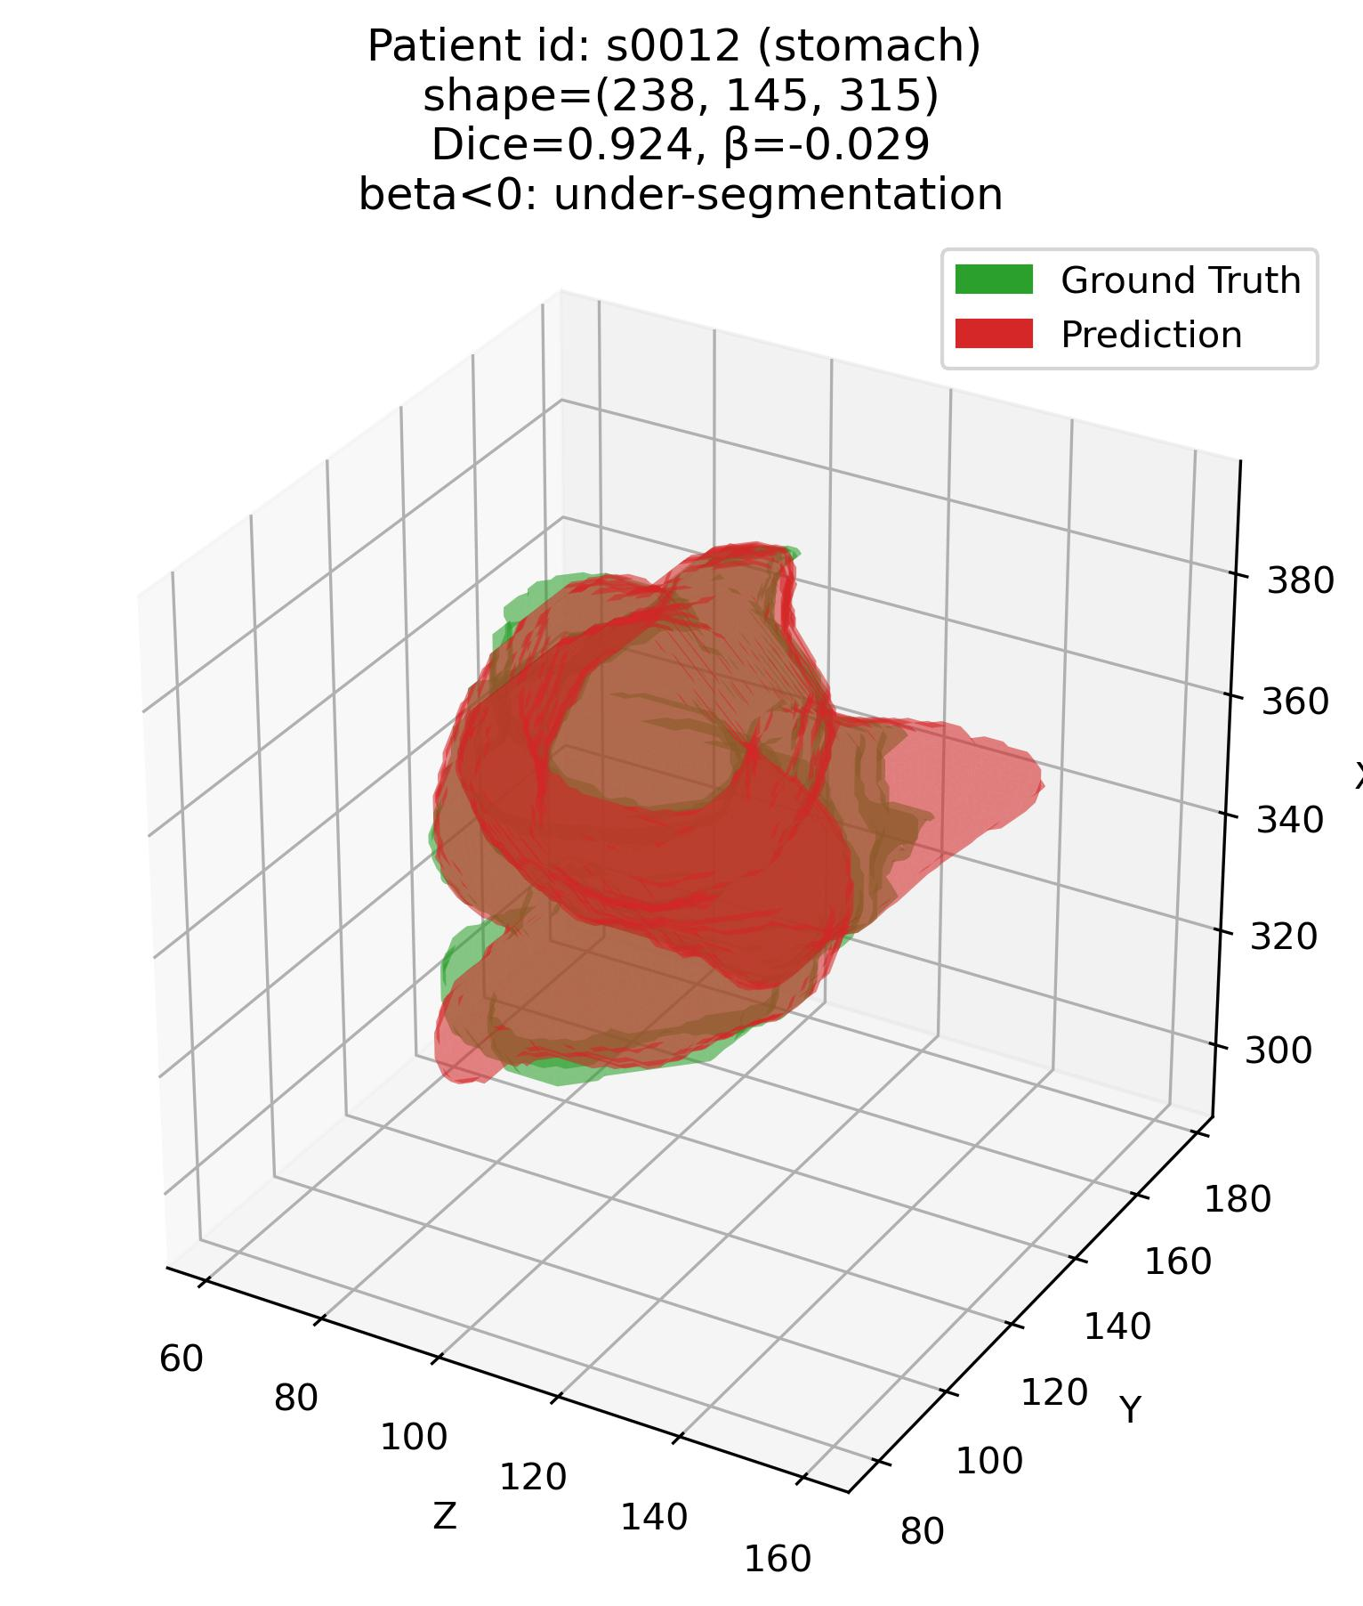
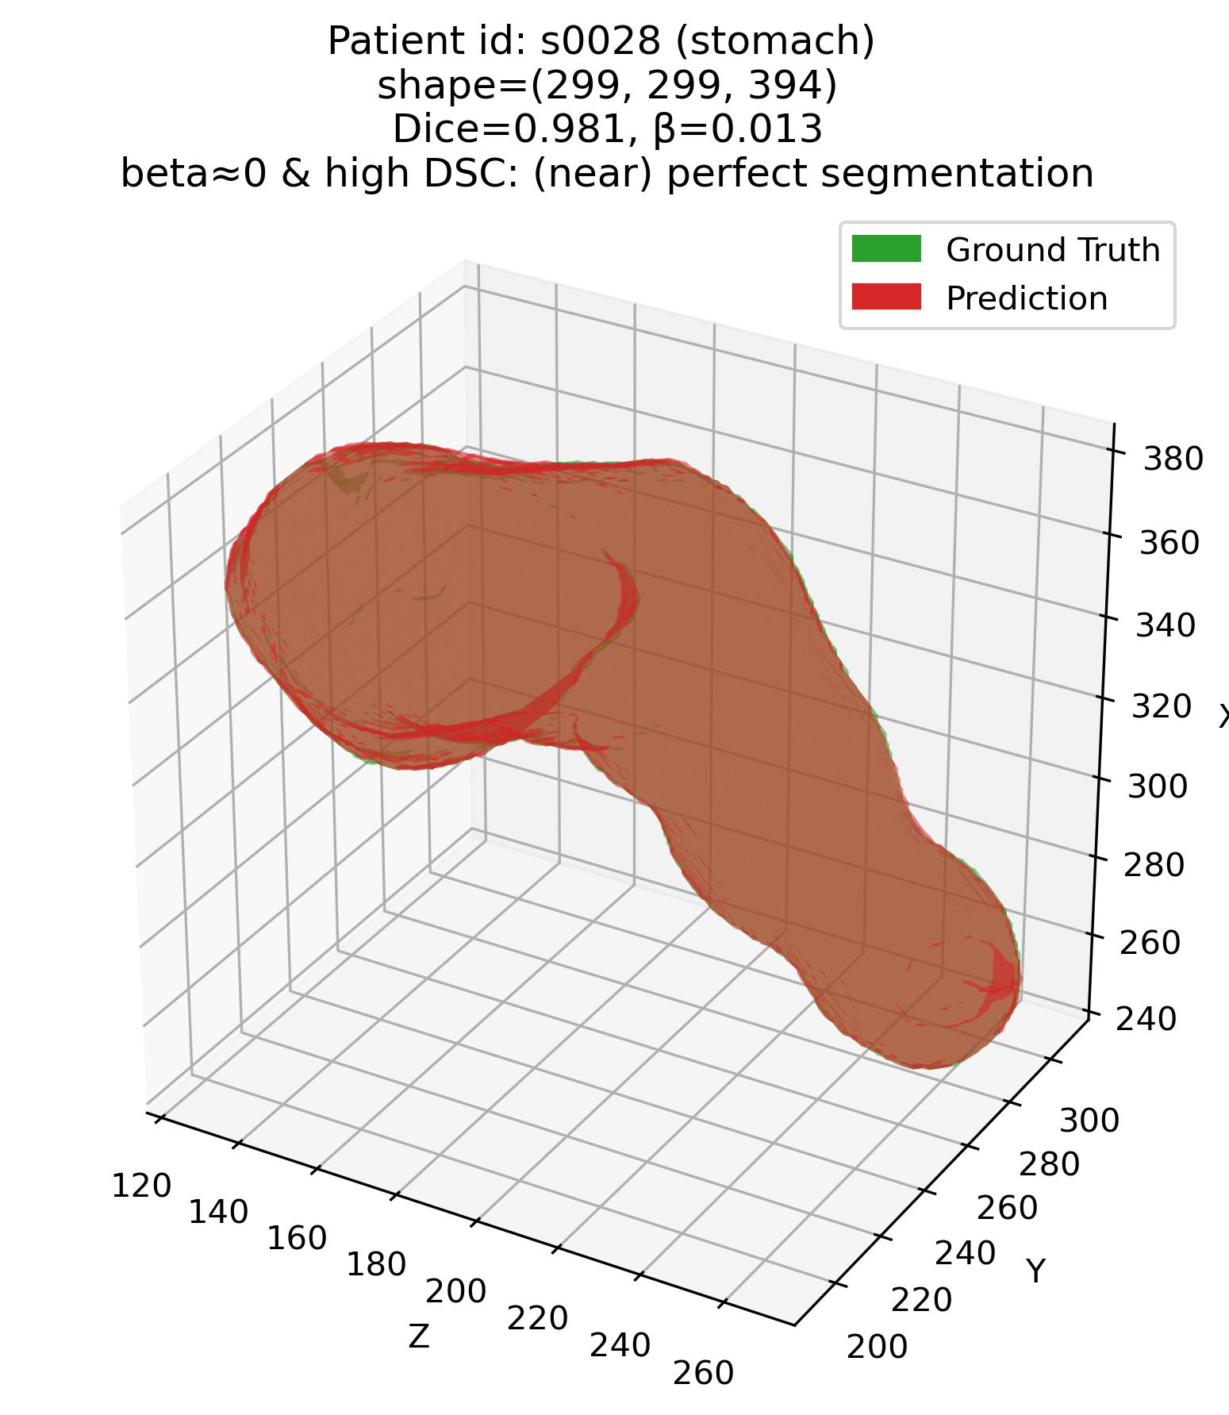
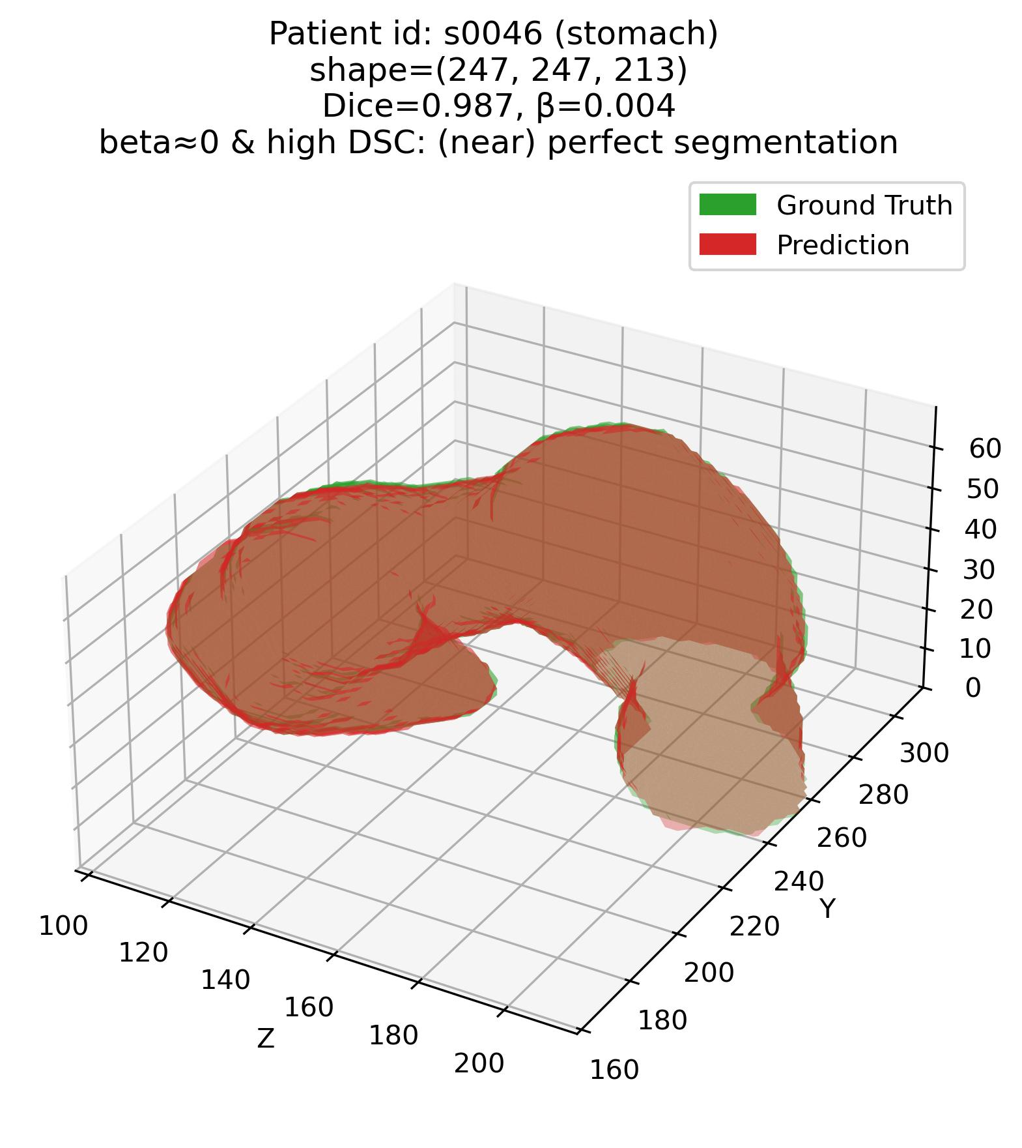
Results 1 – Visual
Efficacy of the joint $β−DSC$ framework
Q1: Some examples – 4. Stomach (Moderate – average DSC organ)

Slide 19
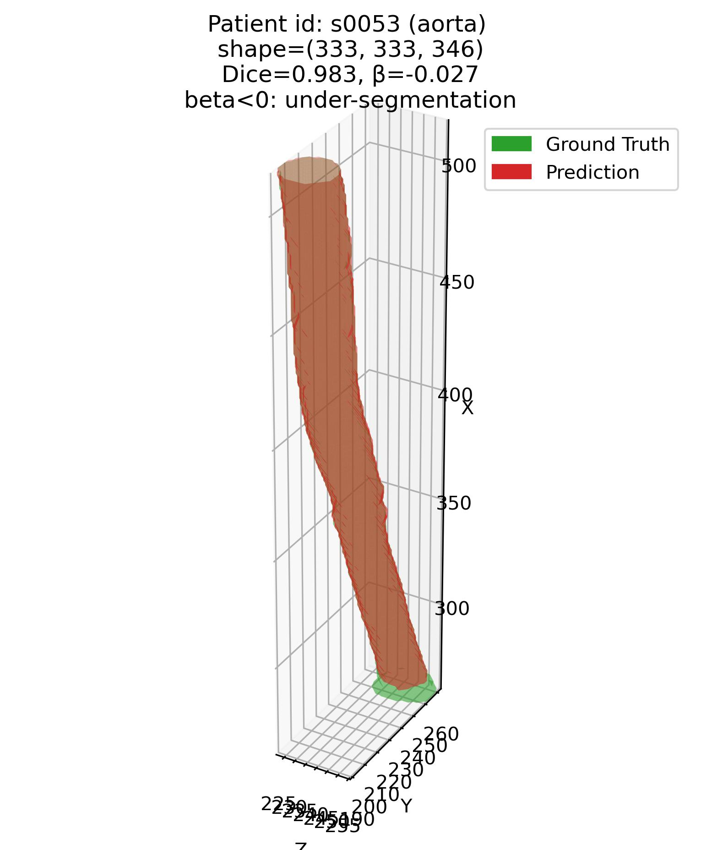
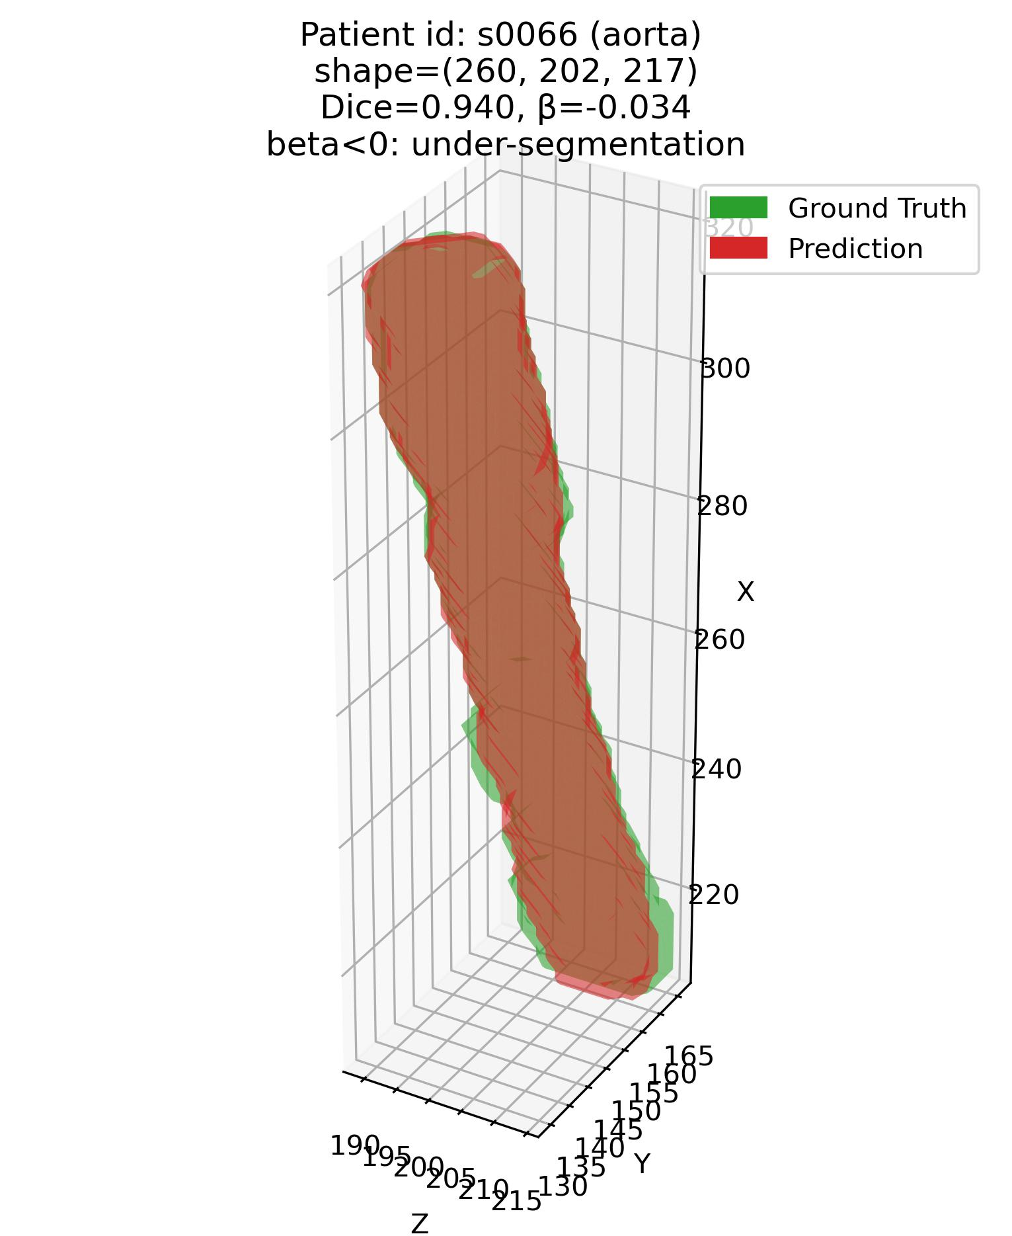
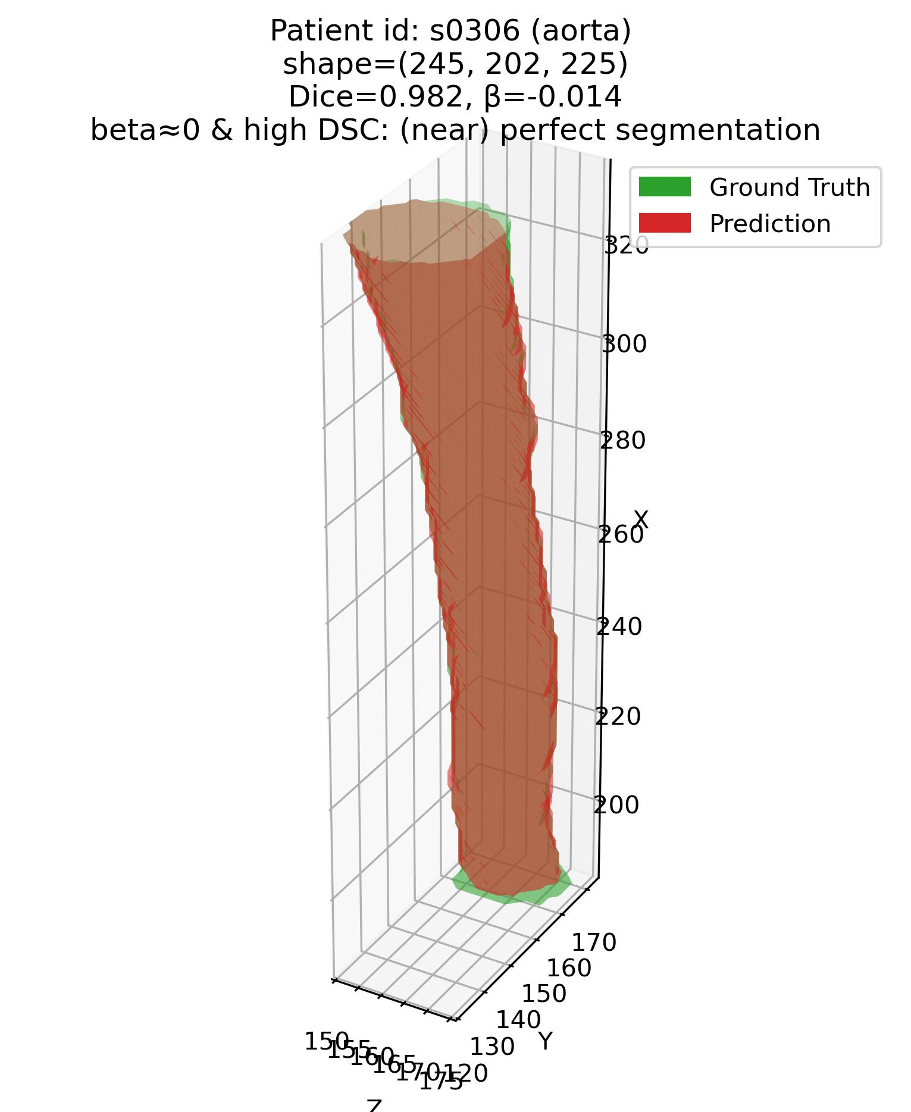
Results 1 – Visual
Efficacy of the joint $β−DSC$ framework
Q1: Some examples – 5. Aorta (Moderate – average DSC organ)

Slide 20
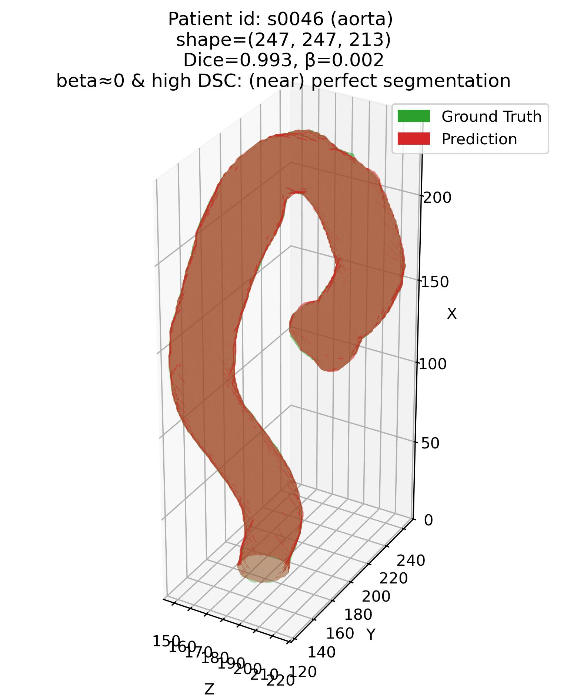
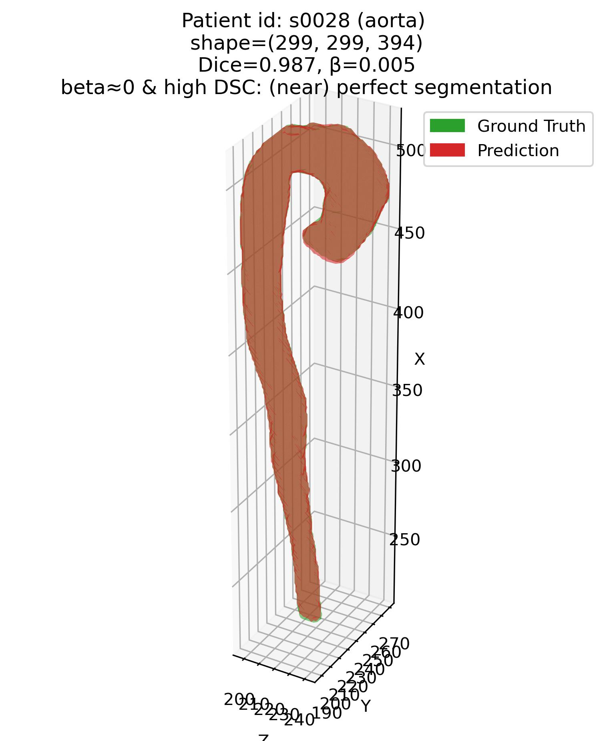
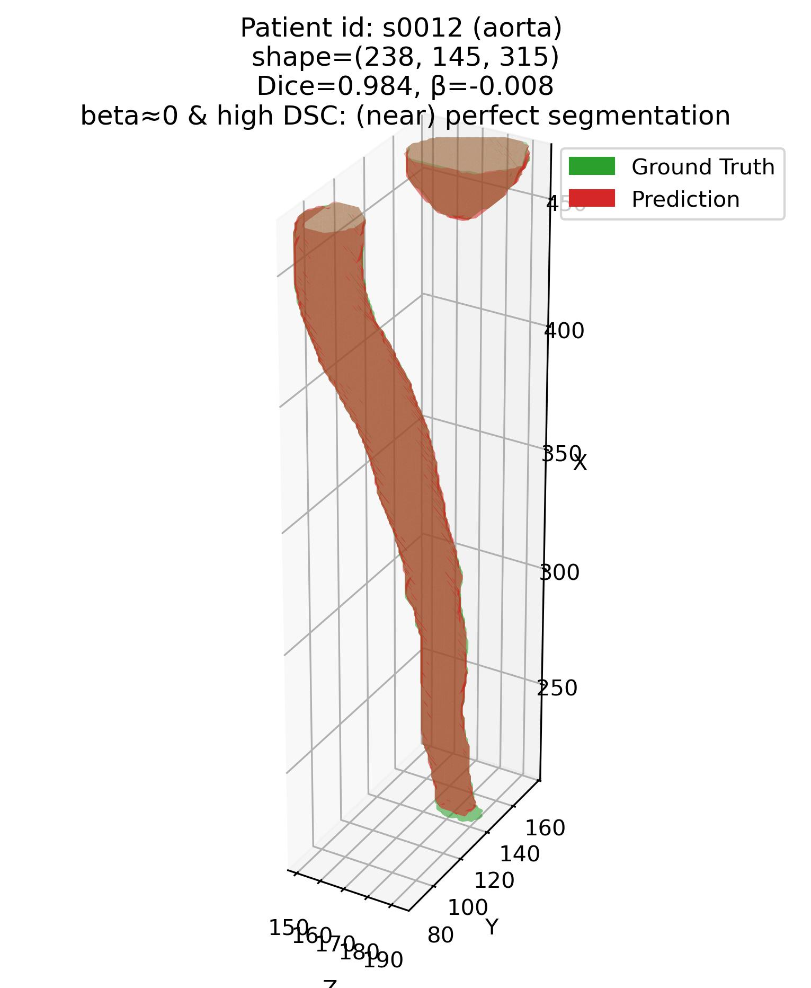
Results 1 – Visual
Efficacy of the joint $β−DSC$ framework
Q1: Some examples – 5. Aorta (Moderate – average DSC organ)

Slide 21
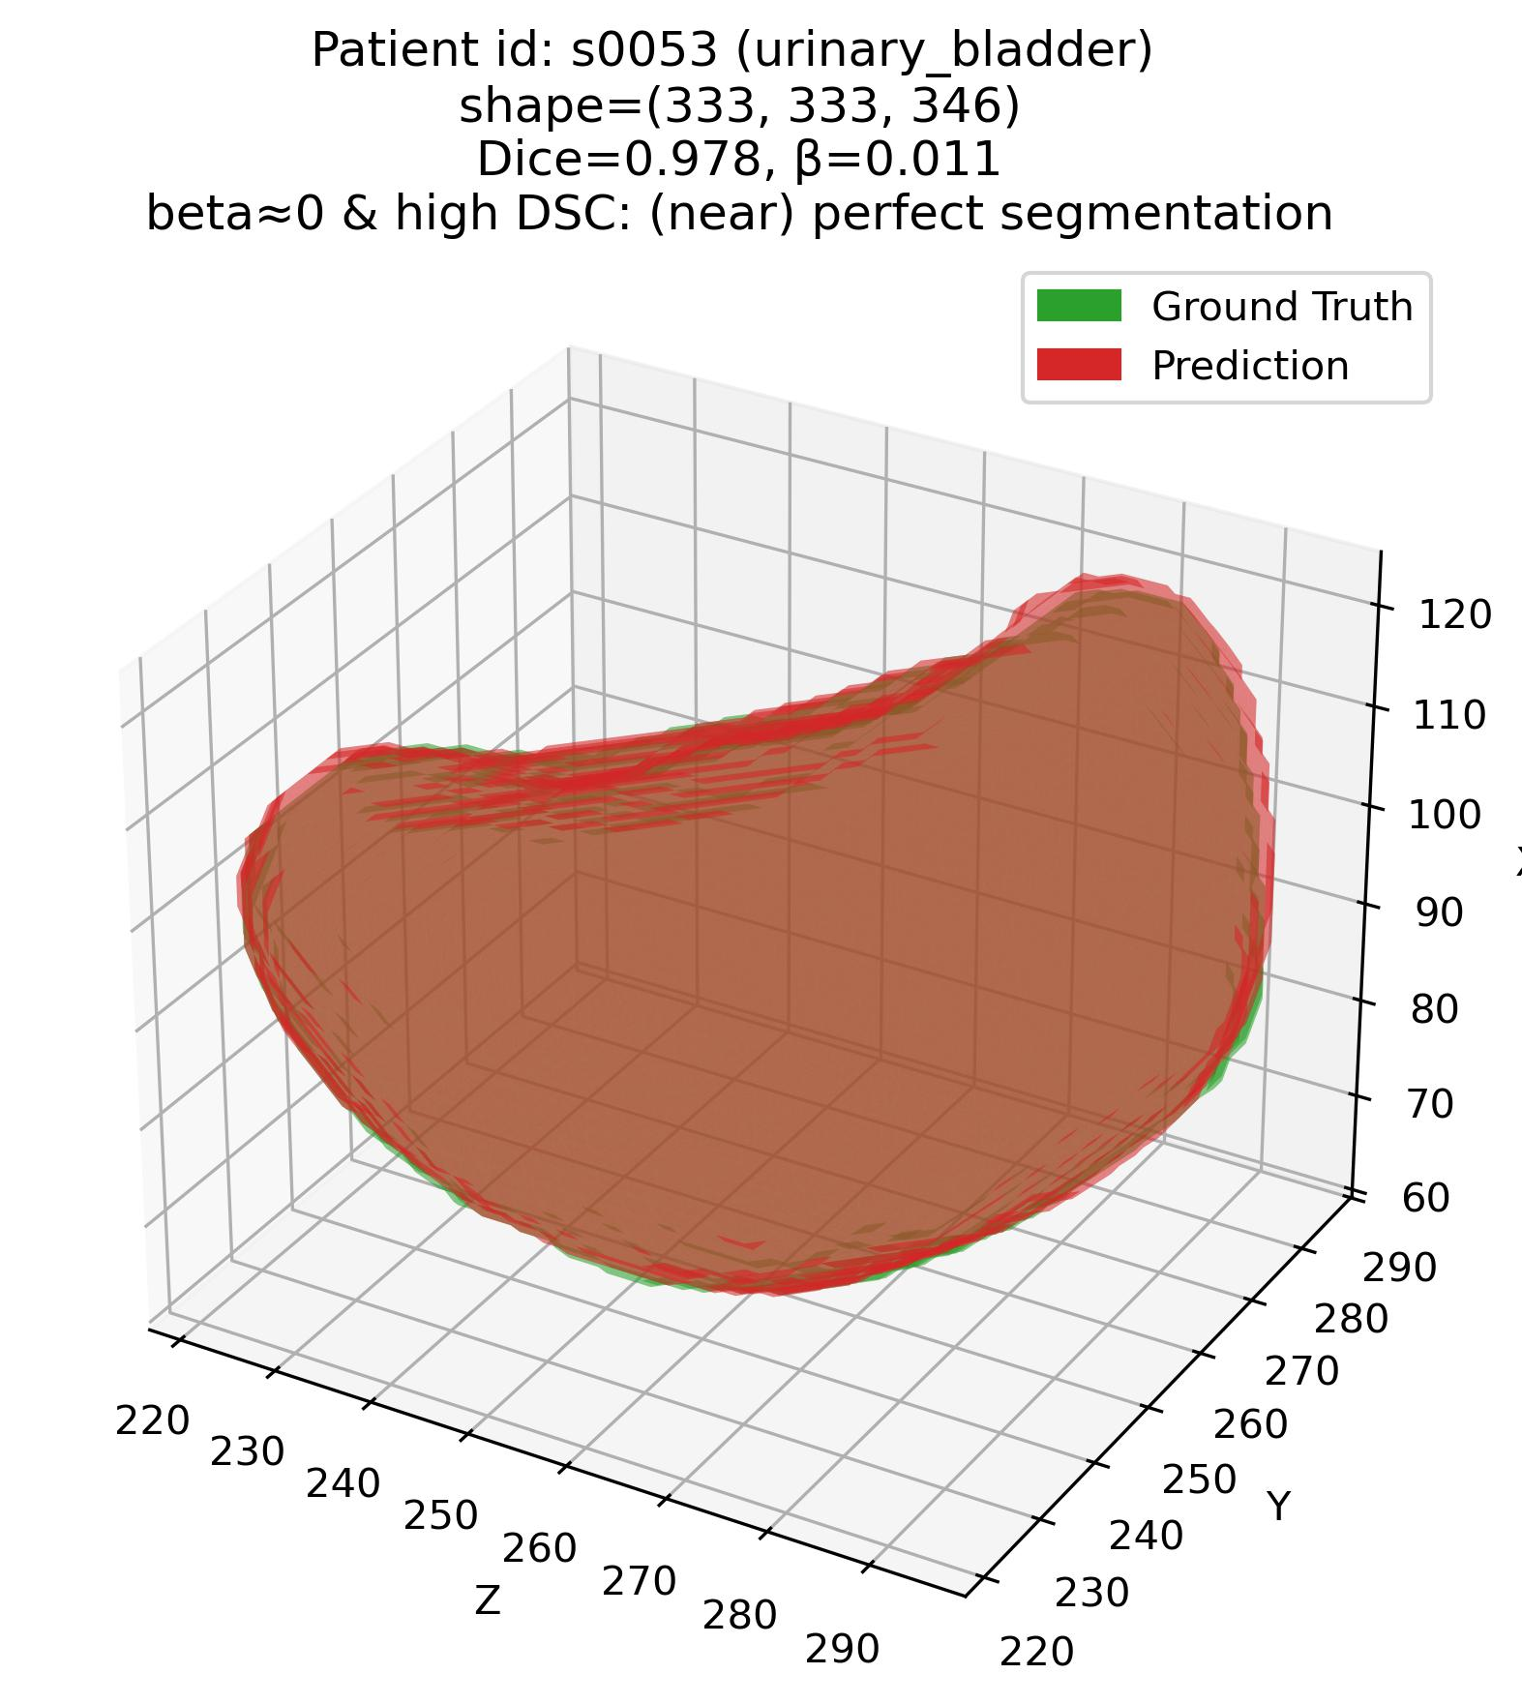
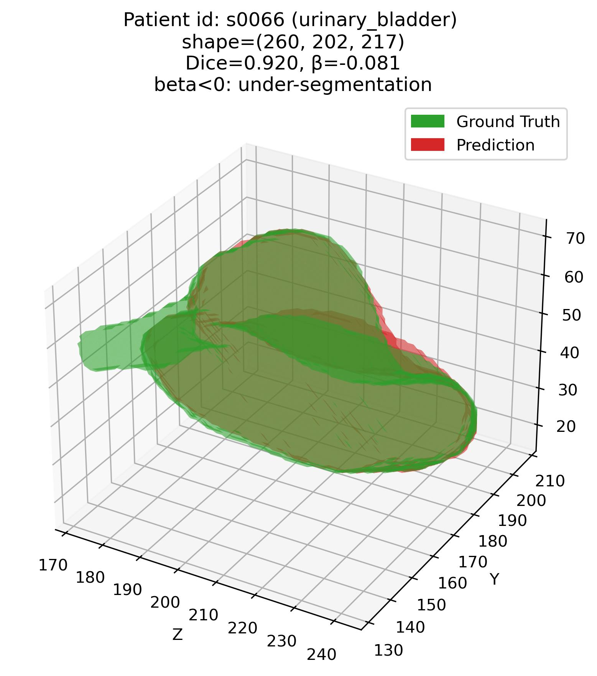
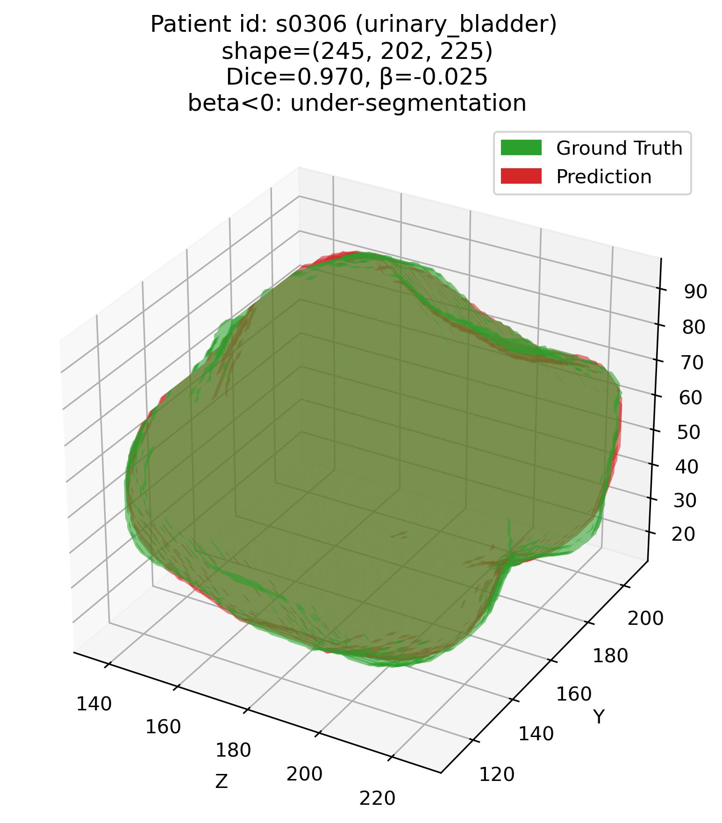
Results 1 – Visual
Efficacy of the joint $β−DSC$ framework
Q1: Some examples – 6. Urinary bladder (Moderate – average DSC organ)

Slide 22



Results 1 – Visual
Efficacy of the joint $β−DSC$ framework
Q1: Some examples – 6. Urinary bladder (Moderate – average DSC organ)

Slide 23



Results 1 – Visual
Efficacy of the joint $β−DSC$ framework
Q1: Some examples – 7. Gall bladder (Moderate – average DSC organ)

Slide 24



Results 1 – Visual
Efficacy of the joint $β−DSC$ framework
Q1: Some examples – 7. Gall bladder (Moderate – average DSC organ)

Slide 25



Results 1 – Visual
Efficacy of the joint $β−DSC$ framework
Q1: Some examples – 8. Pancreas (Difficult – low DSC organ)

Slide 26



Results 1 – Visual
Efficacy of the joint $β−DSC$ framework
Q1: Some examples – 8. Pancreas (Difficult – low DSC organ)

Slide 27



Results 1 – Visual
Efficacy of the joint $β−DSC$ framework
Q1: Some examples – 9. Esophagus (Difficult – low DSC organ)

Slide 28



Results 1 – Visual
Efficacy of the joint $β−DSC$ framework
Q1: Some examples – 9. Esophagus (Difficult – low DSC organ)

Slide 29



Results 1 – Visual
Efficacy of the joint $β−DSC$ framework
Q1: Some examples – 10. Colon (Difficult – low DSC organ)

Slide 30



Results 1 – Visual
Efficacy of the joint $β−DSC$ framework
Q1: Some examples – 10. Colon (Difficult – low DSC organ)

Slide 31




Results 1 – Visual
Efficacy of the joint $β−DSC$ framework
Q1: Some examples – 11. Adrenal glands (Difficult – low DSC organ)
Patient# s0053 (adrenal glands)
Patient# s0066 (adrenal glands)

Slide 32




Results 1 – Visual
Efficacy of the joint $β−DSC$ framework
Q1: Some examples – 11. Adrenal glands (Difficult – low DSC organ)
Patient# s0306 (adrenal glands)
Patient# s0046 (adrenal glands)

Slide 33




Results 1 – Visual
Efficacy of the joint $β−DSC$ framework
Q1: Some examples – 11. Adrenal glands (Difficult – low DSC organ)
Patient# s0012 (adrenal glands)
Patient# s0028 (adrenal glands)

Slide 34
Results 1 – Statistical
About the data
About the data
564 abdominal CTs (Total Segmentator) – all containing liver, stomach and pancreas.
Notes:
1. Add test or train set information.

Slide 35


Results 2 – Statistical
R2a: Volume- and SA-based $β−DSC$ framework for error characterization
Q1: Liver (Easy – high DSC organ)
$${DSC}_{high}=80\%=0.80$$
|$β_{tolerance}|=2\%=0.02$
$$\&$$

Slide 36


Results 2 – Statistical
R2a: Volume- and SA-based $β−DSC$ framework for error characterization
Q1: Stomach (Moderate – average DSC organ)
$${DSC}_{high}=80\%=0.80$$
|$β_{tolerance}|=2\%=0.02$
$$\&$$

Slide 37


Results 2 – Statistical
R2a: Volume- and SA-based $β−DSC$ framework for error characterization
Q1: Pancreas (Difficult – low DSC organ)
$${DSC}_{high}=80\%=0.80$$
|$β_{tolerance}|=2\%=0.02$
$$\&$$

Slide 38


Results 2 – Statistical
R2b: Comparison of Volume- vs. SA-based $β−DSC$ framework for error characterization
Q1: How do the volume- vs. SA-based scores perform across organs?
$${DSC}_{high}=80\%=0.80$$
|$β_{tolerance}|=2\%=0.02$
$$\&$$

Slide 39
Next step
– And why is it relevant?
Unifying $β$ and $DSC$
Why is a quantitative metric of under-/ over-segmentation important?
With a quantitative metric, we can perform correlation, regression et cetera to infer:
What organ features are susceptible to under-/ over-segmentation?
What region in the organ is susceptible to be under-/ over-segmented?
Correlation-/ regression-based analyses are impossible with categorical independent variables.
1. Primary goal: Identifying and characterizing types (not extent, type) of segmentation errors
2. Secondary goal: Fine-grained (specific), completely quantitative, scalable error characterization framework.

Slide 40


Unifying $β$ and $DSC$
– And how to proceed?
Combined score, $C=λ\frac{β+1}{2}+\left(1−λ\right)DSC$
Assumption: During over-segmentation, $Surface area (Pd)≤2×Surface area (GT)$
Error score, $β=\frac{Surface area \left(Pd\right)−Surface area (GT)}{Surface area (GT)}$
Disadvantage: High p-values (two-tailed MWU test with Bonferroni correction) between under-/ over-segmentation and shape match but low DSC (mis-segmentation). That is why this category not shown in the plots. [Work in progress]

Slide 41

Results 2 – Statistical
R2c: $C$ scores across organs
Q1: How do $C$ scores perform across organs?
First, a sanity check:
1. When $λ=0$.00: We fully utilize $DSC$ ➔ $C=DSC$
2. When $λ=0.50$: We give 50% importance to $β$ and $DSC$ ➔ $C=\frac{DSC + {(β+1)}/2}{2}$
3. When $λ=1.00$: We fully utilize $β$ ➔ $C=\frac{β+1}{2}$

Slide 42


Results 2 – Statistical
R2c: $C$ scores across organs
Q1: How do $C$ scores perform across organs? (2)
Sanity check:

Slide 43


Results 2 – Statistical
R2c: $C$ scores across organs
Q1: How do $C$ scores perform across organs? (3)
Liver (Easy – high $DSC$ organ):

Slide 44


Results 2 – Statistical
R2c: $C$ scores across organs
Q1: How do $C$ scores perform across organs? (3)
Stomach (Moderate – medium $DSC$ organ):

Slide 45


Results 2 – Statistical
R2c: $C$ scores across organs
Q1: How do $C$ scores perform across organs? (3)
Pancreas (Difficult – low $DSC$ organ):

Slide 46

An important observation
– And how to address this?
TotalSegmentator (nn-UNet 3D V1) loves to connect disconnected components.
Axiom 1. However, itself sometimes generates disconnected segmentations for connected components.
Axiom 2. Very good at naturally combining disconnected components – almost like “correcting” manual annotation.
Axiom 3. ${Literature}^{\text{[∗]}}$ often suggests that 3D segmentation models perform badly when:
Tiny GT (prostate, various glands – including adrenal glands, urinary bladder)
Complex-shaped GT (esophagus, pancreas, intestines, colon)
However, my observation has been: Disconnected components are a MAJOR factor for a specific kind of over-segmentation.
Axiom 4. Not just ANY over-segmentation – I need to figure out a way to quantify this particular kind of over-segmentation.
[*] Saporta, Adriel, Xiaotong Gui, Ashwin Agrawal, Anuj Pareek, Steven Q. H. Truong, Chanh D. T. Nguyen, Van-Doan Ngo, et al. 2022. “Benchmarking Saliency Methods for Chest X-Ray Interpretation.” Nature Machine Intelligence 4 (10): 867–78.

Slide 47
An important observation
– And how to address this?
TotalSegmentator (nn-UNet 3D V1) loves to connect disconnected components.
Axiom 1. Itself sometimes generates disconnected segmentations for connected components.

Slide 48
An important observation
– And how to address this?
TotalSegmentator (nn-UNet 3D V1) loves to connect disconnected components.
Axiom 2. Very good at naturally combining disconnected components – almost like “correcting” manual annotation.

Slide 49
Recap of to-dos for next week
– What do I want to address/ answer?
1. Combined $β−DSC$ score, $C=λ\frac{β+1}{2}+\left(1−λ\right)DSC$
– For shape match but low DSC (mis-segmentation) versus over/ under segmentation?
2. Quantifying # of connected components + shape completeness/ congruency
Just quantification of over-segmentation error does not suffice – this is a special case.

Slide 50


Summarizing it all
– What was done last week? What is to be done next week?
Past week: What was expected, what was accomplished?
TotalSegmentator → all samples, all organs.
Joint $error score (β)−DSC$ framework coded.
This framework was applied on all eleven, selected abdominal organs.
Observations made.
Combined formulation proposed for the joint score.
Next week: What is expected?
Complete implementation combined score, $C$ for shape match but low DSC (mis-segmentation) versus over/ under segmentation.
Formulate metric to quantify connected component behavior.

Slide 51
Error characterization protocol
References
[1] Jeon, Sun Kyung, Ijin Joo, Junghoan Park, Jong-Min Kim, Sang Joon Park, and Soon Ho Yoon. 2024. “Fully-Automated Multi-Organ Segmentation Tool Applicable to Both Non-Contrast and Post-Contrast Abdominal CT: Deep Learning Algorithm Developed Using Dual-Energy CT Images.” Scientific Reports 14 (1): 4378.
[2] Luo, Xiangde, Wenjun Liao, Jianghong Xiao, Jieneng Chen, Tao Song, Xiaofan Zhang, Kang Li, Dimitris N. Metaxas, Guotai Wang, and Shaoting Zhang. 2022. “WORD: A Large Scale Dataset, Benchmark and Clinical Applicable Study for Abdominal Organ Segmentation from CT Image.” Medical Image Analysis 82 (102642): 102642.
[3] Ji, Yuanfeng, Haotian Bai, Jie Yang, Chongjian Ge, Ye Zhu, Ruimao Zhang, Zhen Li, et al. 2022. “AMOS: A Large-Scale Abdominal Multi-Organ Benchmark for Versatile Medical Image Segmentation.” arXiv [Eess.IV]. arXiv. https://proceedings.neurips.cc/paper_files/paper/2022/file/ee604e1bedbd069d9fc9328b7b9584be-Paper-Datasets_and_Benchmarks.pdf.
[4] Wasserthal, Jakob, Hanns-Christian Breit, Manfred T. Meyer, Maurice Pradella, Daniel Hinck, Alexander W. Sauter, Tobias Heye, et al. 2023. “TotalSegmentator: Robust Segmentation of 104 Anatomic Structures in CT Images.” Radiology. Artificial Intelligence 5 (5): e230024.
[5] Bionetworks, Sage. n.d. “Multi-Atlas Labeling Beyond the Cranial Vault - Workshop and Challenge.” Accessed December 16, 2025. https://www.synapse.org/Synapse:syn3193805/wiki/89480.

Slide 52
Error characterization protocol
References
[6] “MICCAI FLARE 2022 - Grand Challenge.” n.d. Grand-challenge.org. Accessed December 16, 2025. https://flare22.grand-challenge.org/.
[7] Saporta, Adriel, Xiaotong Gui, Ashwin Agrawal, Anuj Pareek, Steven Q. H. Truong, Chanh D. T. Nguyen, Van-Doan Ngo, et al. 2022. “Benchmarking Saliency Methods for Chest X-Ray Interpretation.” Nature Machine Intelligence 4 (10): 867–78.

Slide 53
Error characterization protocol
Appendices
Appendices

Slide 54
Error characterization protocol
Appendices
A1. Next steps in the “How?”

Slide 55

A1. Next steps in the “How?”
Recap – Phase 1
Q1: Can we rank organs as per susceptibility to being under- or over-segmented?
A: The error score, $β:$
Completely quantitative, size-normalized metric that tells you degree of under/ over-segmentation

Slide 56
A1. Next steps in the “How?”
Phase 2
Q2: Organ-wise characterization of more nuanced errors
Comparative analyses:
Same feature b/w ground truth (GT) & predicted (Pd)
Correlation
Simple linear regression
Explanatory (causal) analyses:
Different feature between GT and Pd
Regression
Correlation

Slide 57
A1. Next steps in the “How?”
Phase 3
Q3: Magnitude and direction of error relative to the organ
Magnitude and direction of anisotropy + DSC:
DSC + Magnitude of anisotropy + Direction
Combines magnitude, direction, normalization by size, ignores local statistics:
Shape preservation metric, M1

Slide 58

A1. Next steps in the “How?”
Phase 4
Q4: Which organ-specific features are scalable, and by how much?
Comparative analysis:
What are the exceptions?
Explanatory (causal analyses):
Why the exceptions?
Framework, F1
Fit decision tree classifier to identify what combinations of feature values lead to low versus high deformation ($ΔE$).

Slide 59
Error characterization protocol
Appendices
A2. Methods
– Extending the “How”

Slide 60
A2. Methods
Extending the “How”
Q2: Organ-wise characterization of more nuanced errors
Types of analyses:
1. Purely comparative
2. Explanatory (causal)
How does the segmentation model wrongly alter the segmentation characteristics of the organ?
What organ features lead to what kinds of errors?
Examples
Examples
E1. Do models tend to make elongated structured more circular?
E1. Does a rectangular liver lead to under-segmentation as compared to a spherical liver?
E2. Do models tend to combine small sub-structures into a bigger structure?
E2. Is a complex shape more likely to be over-segmented?

Slide 61



A2. Methods
Extending the “How”
Q2: Organ-wise characterization of more nuanced errors (2)
1. Purely comparative analyses:
E1. Do models tend to make elongated structured more circular?
E2. Do models tend to combine small sub-structures into a bigger structure?
E3. Do models tend to make nuanced shapes seem more simplistic?
Comparison criteria: same feature in the GT and Pd segmentations.

Slide 62
A2. Methods
Extending the “How”
Q2: Organ-wise characterization of more nuanced errors (3)
1. Purely comparative analyses (contd.):
Comparison techniques:
Correlation
Regression (e.g. Simple Linear Regression)
Regression coefficient tells us how much the feature F of the Pd segmentation increases (+ve) or decreases (-ve) with unit increase in F of GT.

Slide 63
A2. Methods
Extending the “How”
Q2: Organ-wise characterization of more nuanced errors (4)
2. Explanatory (causal) analyses:
E1. Does a rectangular liver lead to under-segmentation as compared to a spherical liver?
E2. Is a complex shape more likely to be over-segmented?
Comparison criteria: different feature $F_{x}$ in the GT as $F_{y}$ for Pd segmentations.
Note: Error score $β$, is one of the $F_{y}$ features, as we are also interested in what shape statistics might be causing under- or over-segmentation.

Slide 64

A2. Methods
Extending the “How”
Q2: Organ-wise characterization of more nuanced errors (5)
2. Explanatory (causal) analyses (contd.):
Comparison techniques:
Correlation
Regression (e.g. Simple Linear Regression)

Slide 65
A2. Methods
Extending the “How”
Q2: Organ-wise characterization of more nuanced errors (6)
Features of interest:
1. Measures of anisotropy
2. Features of shape-based complexity
Anisotropy: The elongatedness (non-symmetry) of the 3D shape as a whole.
Exploratory, based on results. I want to follow a similar approach.
Saporta et al 2022 paper [7] features.

Slide 66



A2. Methods
Extending the “How”
Q2: Organ-wise characterization of more nuanced errors (7)
1. Features of interest – measures of anisotropy:
i. Sphericity: How closely does a 3D shape resemble a sphere?
$$sphericity (V, A)$$
$$\frac{surface area of sphere with volume V}{surface area of the actual object (A)} =\frac{\sqrt[3]{36πV^{2}}}{A}$$

Slide 67



A2. Methods
Extending the “How”
Q2: Organ-wise characterization of more nuanced errors (8)
1. Features of interest – measures of anisotropy (contd.):
ii. Relative surface area excess (RSAE): Ratio of excessive surface area of given 3D geometry, relative to that of largest sphere that can fit completely within the geometry.
$$RSAE$$
$$\frac{Excess surface area (ΔA)}{surface area of largest sphere}$$

Slide 68
A2. Methods
Extending the “How”
Q2: Organ-wise characterization of more nuanced errors (9)
2. Features of interest – shape-based complexity:
Influenced heavily by Saporta et al 2022 paper [7] features → although they used saliency maps.
They followed an exploratory approach – I want to do the same.
Not exactly sure what features are the best – without some results.
Using the features in the Saporta et al 2022 [7] paper as a placeholder/ comparison.

Slide 69

A2. Methods
Extending the “How”
Q2: Organ-wise characterization of more nuanced errors (10)
2. Features of interest – shape-based complexity (contd.):

Slide 70


A2. Methods
Extending the “How”
Q3: Magnitude & direction of error relative to the organ
Goal: Develop a combined metric of 1. anisotropy and 2. direction of the aforementioned anisotropy relative to the organ.
Shape preservation metric$, M1$.

Slide 71



A2. Methods
Extending the “How”
Q3: Magnitude & direction of error relative to the organ (2)
Step 1: Tensor representation of the 3D geometry.
The tensor represents:
Direction of maximum elongation
How elongated the shape is in each axis (x, y, z).
Calculate ${\{λ}_{1},λ_{2},λ_{3}\}$ and $\{{v_{1}}^{→},{v_{2}}^{→},{v_{3}}^{→}\}$ from the shape tensor:
[Note: Detailed math provided in protocol]
$\{{v_{1}}^{→},{v_{2}}^{→},{v_{3}}^{→}\}$ provide the directions of $\{l, b, h\}$.
${\{λ}_{1},λ_{2},λ_{3}\}$ provide the magnitude of elongation along $\{{v_{1}}^{→},{v_{2}}^{→},{v_{3}}^{→}\}$.

Slide 72


A2. Methods
Extending the “How”
Q3: Magnitude & direction of error relative to the organ (3)
Step 2: Calculate absolute difference in deformation b/w GT and Pd segmentation.
Note: Direction not incorporated in this step, only magnitude of difference.
$Elongation (E) =\sqrt{\frac{λ_{2}}{λ_{1}}}$
$ΔE=| E_{GT}−E_{Pd} |$

Slide 73
A2. Methods
Extending the “How”
Q3: Magnitude & direction of error relative to the organ (4)
Step 3: Find alignment b/w major axes of GT and Pd segmentation – How aligned are they?
Note: Direction incorporated in this step.
$Alignment {\left(φ\right)=cos}^{−1}\text{|}{v_{1, GT}}^{→}\text{. }{v_{1, Pd}}^{→}\text{|​}$

Slide 74

A2. Methods
Extending the “How”
Q3: Magnitude & direction of error relative to the organ (5)
Reporting elongation + alignment metrics + DSC/NSD/IoU:
DSC/NSD/IoU → for overlap,
$ΔE$ → for magnitude of elongation, and
$φ$ → for alignment of elongation
… between GT and Pd segmentation.
Can be reported per-organ like we do DSC.
But, comparative or explanatory (causal) analyses impossible → because correlation/ regression impossible.

Slide 75
A2. Methods
Extending the “How”
Q3: Magnitude & direction of error relative to the organ (5)
Bringing all the components together:
Shape preservation metric, $M1=e^{−ΔE}\text{|}{v_{1, GT}}^{→}\text{. }{v_{1, Pd}}^{→}\text{|​}$
$Range of M1:$
$0,$ when shape is perfectly preserved b/w GT and Pd segmentations.
$1,$ when shape is completely lost b/w GT and Pd segmentations.
Comparative or explanatory (causal) analyses possible → because correlation/ regression possible.

Slide 76
A2. Methods
Extending the “How”
Q4: Scalability analyses
Which organ-specific features are scalable – and by how much?
Assumption: I have managed to come up with a good metric that unifies $β$ and $DSC$.
In progress: $β=kβ+\left(1−DSC\right),$ where $0≤k≤1$ controls to what extent $β$ is to be used.

Slide 77




A2. Methods
Extending the “How”
Q4: Scalability analyses (2)
Step 1: Fit a Gaussian mixture model (GMM) to the error score ($β$) per organ. Subsequently, find optimal number of components (N) in the GMM-fitted data.
Example data: Histogram of $β$ values
GMM fit on $β$ values (3 modes)

Slide 78
A2. Methods
Extending the “How”
Q4: Scalability analyses (2)
Step 2: Extract shape-based features from each of the 3 components corresponding to “under,” “mixed” and “over” segmentation – based on $β−DSC$ combinations.
Step 3: Perform feature selection to find features that are most important in classifying “under,” “mixed” and “bad” segmentations.
⇒ Example: Say, livers that have low circularity, high area and high circumference are associated with “over” segmentations.

Slide 79
A2. Methods
Extending the “How”
Q4: Scalability analyses (3)
Going one level deeper:
For feature values that have been identified as causing errors in under/ mixed/ over segmentation, can we tell if they lead to a specific type of under/ mixed/ over segmentation?
⇒ Example before: Say, livers that have low circularity, high area and high circumference are associated with “over” segmentations.
Step 4: Label each “over” segmentation as “low deformation” (preserves GT shape — low $ΔE$), or “high deformation” (does not preserve GT shape — high $ΔE$).

Slide 80
A2. Methods
Extending the “How”
Q4: Scalability analyses (4)
Step 5. Fit a decision tree classifier to identify what combinations of feature values lead to low versus high deformation.
⇒ This could be done for any number of aforementioned features — often in the order that we are interested in to get more fine-grained insights.

Slide 81
Error characterization protocol
Appendices
A3. Organs arranged in order of difficulty of segmentation

Slide 82

Organ-wise segmentation quality
... And the organs that we are focusing on
Several benchmarking studies exist, which categorize organs based on difficulty of segmentation by AI-based models [1—4]:
Score | Explanation
Dice Similarity Coefficient (DSC) | Volume (V) overlap
Intersection over Union (IoU) | Surface area (SA) overlap
Normalized Surface Dice (NSD) | Boundary overlap within tolerance distance $t$.
[1] Jeon et al, 2024, Scientific Reports.
[3] Ji et al, 2022, “AMOS,” arXiv, PDF.
[2] Luo et al, 2022, Medical Image Analysis.
[4] Wasserthal et al, 2023, “TotalSegmentator,” Radiology. Artificial Intelligence.

Slide 83
Error characterization protocol
Appendices
A4. Design decisions

Slide 84
A4. Design decisions
D1 – Organs that we are focusing on
D1 – Organs that we are focusing on:
At least for the initial analyses, we focus on the organs fully contained within abdominal CT volumes, namely:
To be excluded:
1. Small intestine
2. Appendix
3. Bile ducts
4. Inferior vena cava
5. Arteries and veins
6. Spine
8. Lymph nodes
9. Lower ribs
1. Liver
2. Pancreas
3. Esophagus
4. Kidneys
5. Adrenal glands
6. Stomach
7. Colon
8. Bladder
9. Gallbladder
10. Aorta

Slide 85
A4. Design decisions
D1 – Organs that we are focusing on (2)
D1 – Organs that we are focusing on (2):
Why small intestine, appendix, bile ducts, inferior vena cava, arteries and veins, lymph nodes, spine and lower ribs are not included:
They are not “popular” organs, meaning I have not seen them being segmented in many abdominal CT studies.
Consequently, not all databases have these ground truths.
Small intestine, large intestine → often tough to differentiate, also not complete in abdominal CT scans often.
Spine → Not a “popular” thing, also not completely contained in abdominal CT scans.

Slide 86
A4. Design decisions
D2 – CT datasets to be used in the study
D2 – CT datasets to be used in the study:
Selection criteria:
We plan on running pre-trained AI segmentation models on popular CT datasets that fulfill the following criteria:
Criteria 1: Contain either all or a subset of the 11 aforementioned, popular (meaning, commonly studied in segmentation studies on CT datasets), abdominal organs that we are interested in:
1. Liver
2. Pancreas
3. Esophagus
4. Kidneys
5. Adrenal glands
6. Stomach
7. Colon
8. Bladder
9. Gallbladder
10. Aorta

Slide 87
A4. Design decisions
D2 – CT datasets to be used in the study (2)
D2 – CT datasets to be used in the study (2):
Criteria 2: Contain at least 30 CT volumes.
Criteria 3: All volumes in 3D — not 2D (meaning, having multiple 2D slices).
Criteria 4: Have published an AI segmentation model on their data — or are popular enough. Meaning, published at a popular venue such as NeurIPS, CVPR, MICCAI, MIDL et cetera — and therefore have an extensive leaderboard.

Slide 88
A4. Design decisions
D2 – CT datasets to be used in the study (3)
D2 – CT datasets to be used in the study (3):
I plan on using 6, 3D CT datasets that follow the aforementioned criteria:
The DECT/ SECT dataset [1]
TotalSegmentator [4]
WORD [2]
BTCV [5]
AMOS [3]
FLARE [6]

Slide 89
A4. Design decisions
D3 – AI segmentation models
D3 – AI segmentation models:
4 popular nnUNET-based models + TotalSegmentator:
nnUNET (2D)
nnUNET (3D)
nnUNETV2 (2D)
nnUNETV2 (3D)
TotalSegmentator: It is not a new model methodologically, it is just nnUNet (3D) trained on all organs in the body, across 1200 3D volumes.

Slide 90
A4. Design decisions
D3 – AI segmentation models (2)
D3 – AI segmentation models (2):
However, for now, we will not use all models – only nnUNET (3D) and TotalSegmentator:
nnUNET (2D)
nUNET (3D) – and TotalSegmentator
nUNETV2 (2D)
nUNETV2 (3D)

Slide 91
A4. Design decisions
D3 – AI segmentation models (3)
D3 – AI segmentation models (3):
Why not nnUNet(2D)?
2D errors do not scale well to actual 3D segmentations (access relevant results here and here)
Nor are they a good means of visualization (access relevant results here)
That is, using selective 2D axial slices for the purpose of visualizing 3D segmentation results is misleading and confusing.

Slide 92
Thank you!

